Slide 1
Safety and health protection at work with biological factors and GMOs
2023
Ing. Csaba Kósa, PhD.
RNDr. Ján Košovský, CSc.
RNDr. I. Režuchová, PhD.

Slide 2
Contents
Introduction
Legislative basis
Basic terms
Classification of biological factors and risk classes
Operating procedure for working with biological factors and GMOs
Protective measures when working with biological factors, including GMOs
Measures in laboratories at protection level 2 (Biosafety Level 2, BSL-2)
Disinfection
Disinfection using sodium hypochlorite

Slide 3
Contents
Protective measures when working with biological factors and GMOs
Sterilization and its control
Health surveillance and vaccination
Informing and training of employees
Cleaning and laundry
Management of waste contaminated with biological factors and GMOs
Organizational and technical measures for disposal of biol. factors and GMOs
Decontamination procedure
Measures in laboratories at protection level 3 (Biosafety Level 3, BSL-3)

Slide 4
Legislative basis
Regulation of the Gov. of the SR No. 83/2013 Coll.: On the protection of the health
of employees from risks related to exposure to biological factors at work.
Act of the NC SR No. 151/2002 Coll. on the use of genetic technologies and genetically modified organisms, as amended
Decree of the Ministry of the Slovak Republic no. 274/2019 Coll., implementing Act No. 151/2002 Coll. on the use of genetic technologies and genetically modified organisms, as amended

Slide 5
Basic terms
Biological factors are:
microorganisms (viruses, bacteria, fungi), including genetically modified microorganisms,
cell cultures
human endoparasites that can cause infection, allergy or toxic effects in humans;
prions that can cause communicable disease in humans
Microorganisms are
microbiological cellular individuals or non-cellular individuals that are capable of the process of duplication or transfer of genetic material,
Cell cultures are
populations of cells obtained by culturing multicellular organisms under laboratory conditions,
Genetically modified organisms/microorganisms (GMOs) are
organisms - cell cultures, viruses, bacteria, yeast, insects, animals, etc., whose genetic material has been changed in a way that does not naturally occur during sexual reproduction and natural recombination,

Slide 6
Classification of biological factors and risk classes
Based on the degree of risk of infection in humans, biological factors are classified into
*- Risk Group 1 (no or low individual and community risk) A microorganism that is unlikely to cause human or animal disease.,
*- Risk Group 2 (moderate individual risk, low community risk) A pathogen that can cause human or animal disease but is unlikely to be a serious hazard to laboratory workers, the community, livestock or the environment. Laboratory exposures may cause serious infection, but effective treatment and preventive measures are available and the risk of spread of infection is limited, for example: Borrelia burgdorferi, Escherichia coli; Hepatitis A.
*- Risk Group 3 (high individual risk, low community risk) A pathogen that usually causes serious human or animal disease but does not ordinarily spread from one infected individual to another. Effective treatment and preventive measures are available., for example: Coxiella burnetii, some rickettsia bacteries.
*WHO Laboratory biosafety manual, third edition

Slide 7
Classification of biological factors and risk classes
Based on the degree of risk of infection in humans, biological factors are classified into
*- Risk Group 4 (high individual and community risk) A pathogen that usually causes serious human or animal disease and that can be readily transmitted from one individual to another, directly or indirectly. Effective treatment and preventive measures are not usually available, for example Variola virus, Ebola.
If a biological factor cannot be clearly classified as a factor of one of the groups mentioned above, this factor is classified as a factor of a group with a higher risk level.
*WHO Laboratory biosafety manual, third edition

Slide 8
Classification of biological factors and risk classes
Classification of biological factors is listed in Annex no. 2. of the Regulation of the Gov. of the SR No. 83/2013 Coll.:
Only factors known to cause infection in humans are included in the list of classified factors (hereinafter referred to as "the list").
The list is based on the effects of biological factors on healthy people.
Biological factors that are not classified in the list as factors of the 2nd to 4th groups are not automatically classified as factors of the 1st group.
If a strain is attenuated or has lost known virulence genes, the level of protection required by its strain classification does not necessarily apply, but is subject to an appropriate workplace risk assessment. This is if such a strain is to be used as a product or part of a product for prophylactic or therapeutic purposes.

Slide 9
Classification of biological factors and risk classes
Classification of biological factors is listed in Annex no. 2. of the Regulation of the Gov. of the SR No. 83/2013 Coll.:
All viruses that have already been isolated in humans and that have not yet been evaluated and included in this Annex should be classified as at least Group 2 agents unless it can be demonstrated that they are a biological agent that is unlikely to cause human disease
Certain biological agents classified as Group 3 agents, which are marked with two asterisks (**) in the list, may present a reduced risk of infection to employees, as the infection caused by them is not normally airborne. For such biological factors, the protective measures to be implemented will be evaluated, taking into account the nature of the specific activities and the amount of the relevant biological factor. (e.g., hepatitis B virus (3**) and C virus (3**), HIV virus (3**), tick-borne encephalitis virus (3**)

Slide 10
Risk assessment and classification of the use of GMOs in closed spaces into risk classes
According to §3 and 4 of the Decree of the Ministry of the Ministry of the Slovak Republic no. 274/2019 Coll., implementing Act No. 151/2002 Coll. on the use of genetic technologies and genetically modified organisms, as amended
The risk assessment is aimed at identifying the adverse effects of GMOs on humans and the environment that may occur when using GMOs in closed spaces.
The risk assessment determines the level of risk, preliminarily assigns the use in a confined space to a risk class, and selects a set of protective measures that are appropriate for the preliminary classification and the required level of protection.
The result of the risk assessment is the classification of the use of GMOs in closed spaces in risk classes 1 to 4.

Slide 11
Risk classes when using GMOs in closed spaces
Risk class 1 applies only if the GMOs used have the following properties:
it is unlikely that the recipient organism or the parent organism will cause damage to human health or damage to the health of animals and plants in the environment if they are exposed to its effects,
it is assumed that the nature of the vector and the inserted genetic material do not give the GMO a phenotype that causes damage to human health, damage to the health of animals and plants in the environment if exposed to it, or that results in harmful effects on the environment and
it is assumed that the GMO will not cause disease in humans or animals and plants in the environment if they are exposed to its effects, and that it does not have a harmful effect on the environment.

Slide 12
Risk classes when using GMOs in closed spaces
If the properties of the GMO valid for risk class 1 are not demonstrated, indoor use shall be classified as:
risk class 2, if it is a small risk that can be easily eliminated by protective measures, especially physical barriers,
risk class 3, if it is a medium-sized risk that can only be eliminated by special demanding protective measures, or
risk class 4, if it is a major risk leaving permanent consequences that cannot be completely eliminated even by the use of particularly demanding protective measures.

Slide 13
Sources of danger when working with biological factors and GMOs
Used biological agents, GMOs and infected laboratory animals
Used contaminated containers, apparatus, laboratory tools, other tools
and medical sharps

Slide 14
How to go through an accident a hazards at work with biological factors and GMOs?
By following correct work procedures and safe work principles
with biological factors and GMOs
"Operational rules for working with biological factors"
"Operational rules for working with GMOs"
Legislative base
Regulation of the Government of the Slovak Republic no. 83/2013 Coll. about health and safety when working with biological factors
§9 paragraph 3) Decree of the Ministry of the Slovak Republic no. 274/2019 Coll., .

Slide 15
Operational rules for working with biological factors
According to § 18 NV SR no. 83/2013 Coll., the operating rules for working with biological factors includes:
assessment on the risk of exposure to biological factors,
data on the location of the workplace, identification of sources of risk from exposure to biological factors, including the risk of injury or infection when performing medical activities, including contact with blood or other potentially infectious material,
description of the technology or activity, equipment of the workplace in terms of construction, material and technical aspects, including control systems to prevent the leakage or transmission of biological factors in the workplace,
provision of protective and preventive measures with regard to the required level of protection, including measures for the safe handling and transport of biological factors at the workplace and measures for the prevention of injury or infection during the performance of medical activities,

Slide 16
Operational rules for working with biological factors
According to § 18 NV SR no. 83/2013 Coll., the operating rules for working with biological factors includes:
e) emergency plan for the protection of employees against exposure to biological factors of group 3 and group 4, which may arise as a result of a breach of the barriers limiting the level of protection,
f) methods of decontamination and disinfection and control of their effectiveness at the workplace,
g) means for safe collection, temporary storage and disposal of waste containing biological factors, including sharp medical objects,
h) method and frequency of employee training,
i) method of securing vaccination of employees

Slide 17
Operational rules for working with GMOs
According to §9 section3) Decree of the Ministry of the Slovak Republic no. 274/2019 Coll., the operating rule for working GMOs includes.
description of work spaces,
rules for working with genetically modified organisms,
method of storing genetically modified organisms,
method of marking genetically modified organisms,
method of disposal of genetically modified organisms,
conditions for the transfer of genetically modified organisms in closed spaces and in public spaces,
securing closed spaces against the escape of genetically modified organisms during operation,
methods to eliminate genetically modified organisms in the event of their uncontrolled release.

Slide 18
Protective measures when working with biological factors and GMOs
In the premises where biological factors and GMOs are worked (in laboratories, in rooms for experimental animals), it is mandatory to take measures (structural, technical, organizational, hygienic) that ensure an adequate level of protection 2, 3 or 4. degree (Biosafety level 2, 3, 4)
The measures required for individual levels of protection are listed in Annex no. 5 of the SR Government Regulation No. 83/2013 Coll. on protecting the health of employees from risks related to exposure to biological factors at work.
The measures required for individual levels of protection when working with GMOs are listed in Annex no. 1 to decree no. 274/2019 Coll., implementing Act No. 151/2002 Coll. on the use of genetic technologies and genetically modified organisms, as amended.

Slide 19
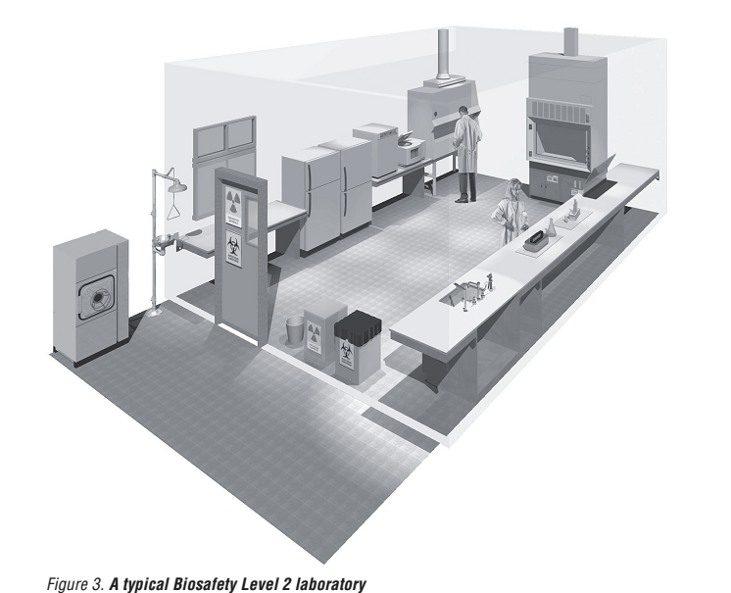
Protective measures when working with biological factors and GMOs
Measures in laboratories at level 2 protection (Biosafety Level 2, BSL-2)
Laboratory biosafety manual
Third edition
World Health Organization
Geneva
2004

Slide 20
Protective measures when working with biological factors and GMOs
Measures in laboratories at level 2 protection (Biosafety Level 2, BSL-2)
- Work areas (laboratories, rooms for experimental animals) are marked with a warning sign Biological danger with a pictogram on a yellow background
- The doors on the rooms marked in this way will be closed during the experiments.
- Laboratories are kept clean, tidy and free of non-work related objects such as outdoor clothing and personal items. The spaces between desks, cabinets and other equipment, as well as the spaces below them, must be accessible for cleaning and possible decontamination.

Slide 21
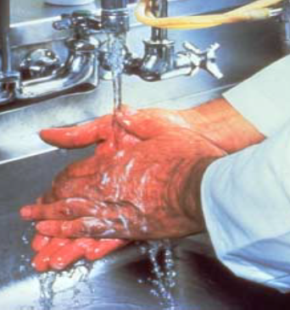
Protective measures when working with biological factors and GMOs
Measures in laboratories at level 2 protection (Biosafety Level 2, BSL-2)
- Protective coats or coveralls are worn in the work areas. It is forbidden to enter offices, kitchens, seminar rooms and the library while wearing protective clothing.
- Protective gloves are always used in direct or possible contact with blood, body fluids or other potentially infectious material.
It is strictly forbidden to grab the door handle with contaminated gloves!!!
Hands must also be washed when leaving the work area.

Slide 22
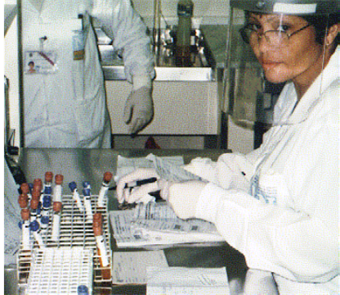
Protective measures when working with biological factors and GMOs
Measures in laboratories at level 2 protection (Biosafety Level 2, BSL-2)
At risk of splashing with infectious or caustic liquids, e.g. sodium hypochlorite, and when working with UV radiation sources (transilluminators), protective glasses or shields are used.

Slide 23
Protective measures when working with biological factors and GMOs
Measures in laboratories at level 2 protection (Biosafety Level 2, BSL-2)
- Eating, drinking, applying cosmetic preparations and storing food and drinks are prohibited in laboratories and breeding rooms.
During laboratory work, the employee should not touch the mouth and eyes, put a pen, pencil or chewing gum in the mouth.

Slide 24
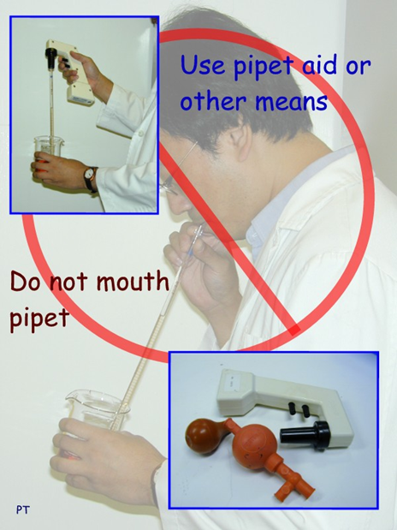
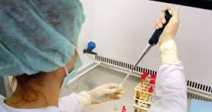
Protective measures when working with biological factors and GMOs
Measures in laboratories at level 2 protection (Biosafety Level 2, BSL-2)
- Liquids containing dangerous chemical substances or biological factors are sucked in and dosed with automatic pipettes in combination with plastic tips.
- For larger volumes (5-25 ml), manual pipettors are used in combination with measuring pipettes. Pipetting by mouth is strictly prohibited.
Suction and dosing is carried out carefully, without unnecessary bubbling, to minimize the formation of aerosols and small droplets.

Slide 25
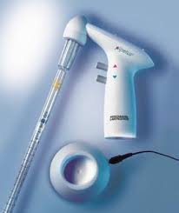
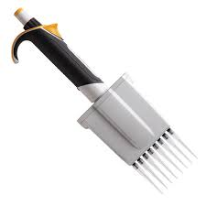
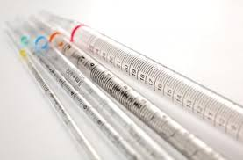
Protective measures when working with biological factors and GMOs
Measures in laboratories at level 2 protection (Biosafety Level 2, BSL-2)
After use, contaminated pipettes are completely immersed in a disinfectant solution poured in an unbreakable container and left in it for the prescribed time. (16-24h)
Automatic pipettes, manual pipettors and other dosing tools are regularly cleaned and disinfected according to the manufacturer's instructions.
- Infectious fluids, microbial cultures and samples are decontaminated thermally, e.g. in an autoclave or by burning, or chemically, e.g. by adding concentrated 15% sodium hypochlorite to the resulting 0.5% concentration (addition of 1/30 of the volume of concentrated 15% NaClO) with an action time of 30 - 60 min.
Decontamination of infectious waste and contaminated objects is preferably carried out in the premises where they originated.

Slide 26
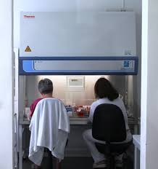
Protective measures when working with biological factors and GMOs
Measures in laboratories at level 2 protection (Biosafety Level 2, BSL-2)
Work performed in laminar boxes
handling of infectious materials, especially with airborne biological factors,
activities with the possibility of aerosols containing biological factors, such as shaking, mixing, sonification, opening of centrifuge cuvettes and containers with internal positive or negative pressure (tubes with samples, lyophilized preparations or liquid cultures of microorganisms).
Preparations of microorganisms are stored in refrigerators, freezers, on dry ice or over liquid nitrogen. The name (code) of the preparation, the date of its preparation and the name of the worker are indicated on the packaging of the stored preparations.

Slide 27
Protective measures when working with biological factors and GMOs
Measures in laboratories at level 2 protection (Biosafety Level 2, BSL-2)
- When handling objects cooled to a very low temperature, the worker must use gloves with thermal insulation (not thin latex gloves!) and protective glasses or a shield when working with liquid nitrogen.
- A high risk of injury is represented by chipped or cracked laboratory glass!!!!
If the nature of the experiment allows it, glass tools are replaced by plastic ones.
- Care must be taken when working with syringes with attached needles.
After use, syringes with needles are discarded as a whole in a strong plastic, clearly marked container.

Slide 28
Protective measures when working with biological factors and GMOs
Measures in laboratories at level 2 protection (Biosafety Level 2, BSL-2)
- To provide first aid, a first aid kit with medical supplies is located in the laboratory or nearby. The first aid kit also includes a book of minor injuries, in which injuries are recorded.
Steam sterilizers (autoclaves)
As a specified technical pressure devices, they must be subject to professional inspections and tests performed by an inspection technician at prescribed intervals.
Likewise, the efficiency control of laminar boxes and other filter devices, including their HEPA filters, is ensured through an authorized organization. Copies of test and test reports of dedicated pressure equipment used in BSL-3 laboratories are given to the employee responsible for health and safety, who archives them.

Slide 29
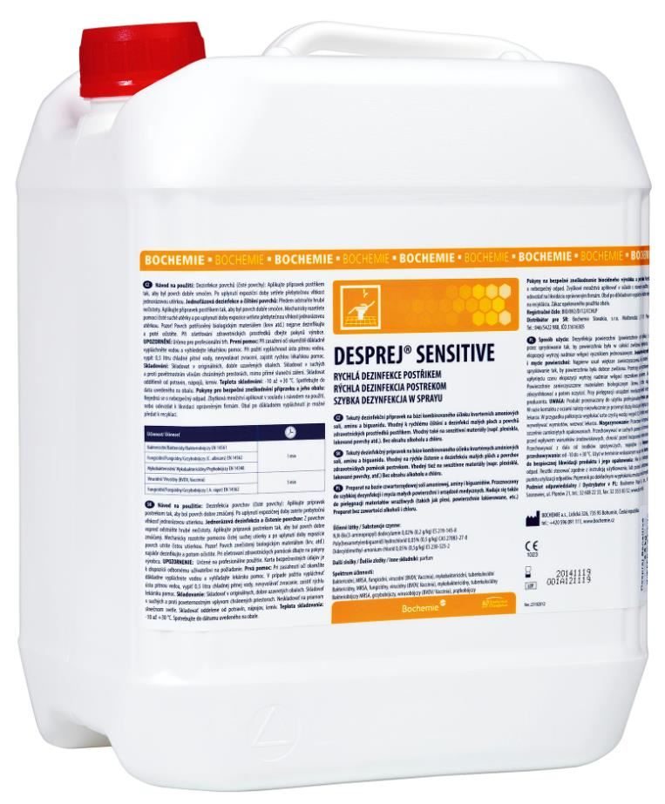
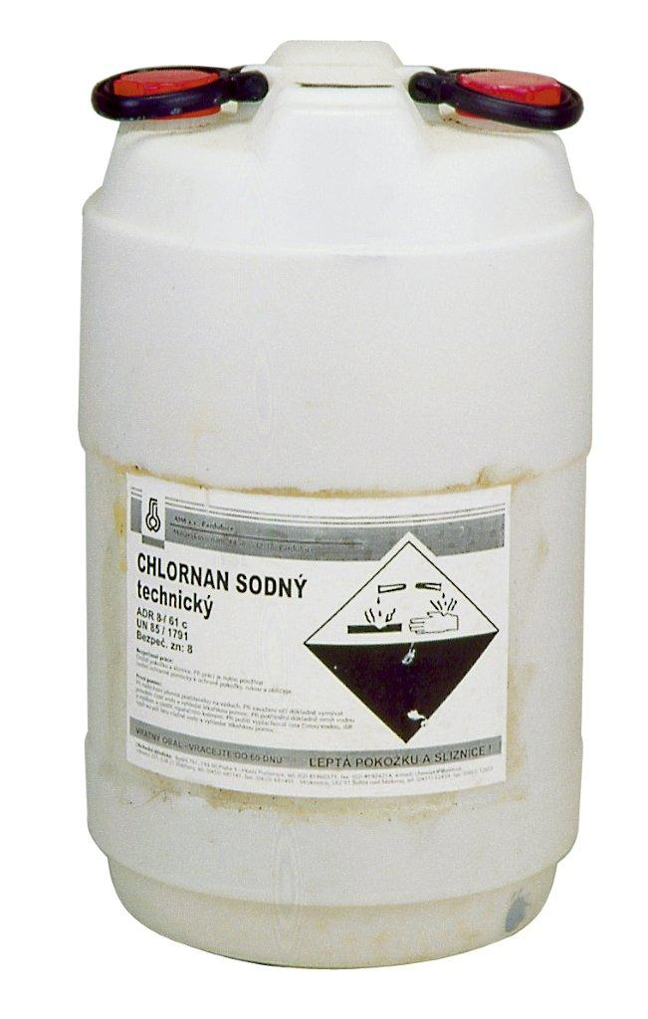
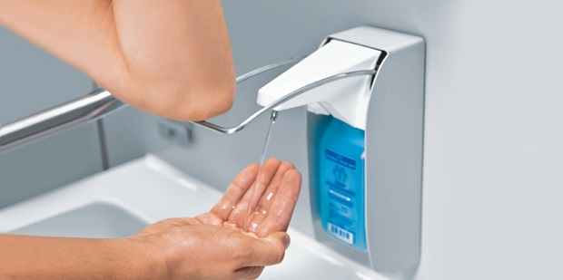
Protective measures when working with biological factors and GMOs
Disinfection

Slide 30
Protective measures when working with biological factors and GMOs
Disinfection
Disinfection
is the destruction of disease-causing microorganisms using physical, chemical or combined procedures that interrupt the transmission of infection from the source - the source of the infection to a susceptible individual. It mostly does not destroy bacterial spores.
In disinfection, facilities and procedures are used that do not damage or cause color change of objects or surfaces.
Practical implementation of disinfection
1. Disinfection with a virucidal agent, e.g. with 0.5% sodium hypochlorite solution
Objects and surfaces are covered with paper wool or gauze and covered with this disinfectant. After 30-60 minutes, the solid material is placed in the infectious waste and then cleaned with ordinary cleaning agents
2. Mechanical cleaning using warm water, detergents and mechanical procedures

Slide 31
Protective measures when working with biological factors and GMOs
Disinfection
Physical disinfection
boiling in water under atmospheric pressure for at least 30 minutes,
boil in pressure vessels for at least 20 minutes,
disinfection in washing, washing and steam devices at a temperature higher than 90 °C for 10 minutes,
flowing hot air at a temperature of 110 °C for 30 minutes,
ultraviolet radiation with a wavelength of 254 - 264 nm,
pasteurization (heating to 63 °C for 30 minutes, 85-90 °C or 134 °C for a few seconds and rapid cooling),
filtration,
h) burning.

Slide 32
Protective measures when working with biological factors and GMOs
Disinfection
Chemical disinfection
In chemical disinfection, microorganisms are destroyed by chemical disinfectants of a specified concentration and exposure time.
Physical-chemical disinfection
It is disinfection in washing, washing and cleaning machines at a temperature of 60 °C and under the action of a chemical disinfectant.

Slide 33
Protective measures when working with biological factors and GMOs
Disinfection
Hand disinfection
Normal hand washing is performed by applying approx. 1 ml of liquid soap, spreading it thoroughly, rinsing under running warm water and drying with a disposable towel.
- It does not kill microorganisms, it just releases them from the skin.
Hygienic hand washing is carried out using 2-3 ml of disinfectant soap, e.g. of a product called Prosavon, which is rubbed into moistened skin for about 1 minute and then rinsed off with running warm water.
- It is more effective than regular washing, because it dissolves and washes away the fat layer from the skin along with microorganisms.

Slide 34
Protective measures when working with biological factors and GMOs
Disinfection
Hand disinfection
Hygienic hand disinfection is carried out with an alcohol disinfectant, e.g. products with the name Softa-Man, Sterillium. At the same time, 2-3 ml of the product is rubbed into dry skin for about 1 minute until the alcohol component evaporates. It is part of anti-epidemic measures when passing through a hygienic filter, it is carried out in case of accidental contamination of hands with biological material or when gloves are torn.

Slide 35
Protective measures when working with biological factors and GMOs
Disinfection
Hand disinfection
Hygienic hand washing combined with disinfection is necessary
a) after grasping an object that is or may be contaminated,
b) after taking off the protective gloves and after finishing the work in the laboratory,
c) before eating, applying cosmetics and after using the toilet.
Finally, the skin of the hands is treated with a regenerating cream

Slide 36
Protective measures when working with biological factors and GMOs
Disinfection
Using sodium hypochlorite (NaClO) as a disinfectant
Most commonly used concentrations:
a) 0.1 - 0.15% (1.0 - 1.5 g / liter) for general disinfection of surfaces,
b) 0.5% (5 g / liter) in cases where there is a greater content of organic substances (proteins, blood, serum) in the environment, such as
- in the inactivation of biological factors,
- during decontamination of spilled biological material,
- when preparing solutions for decontamination of laboratory objects.
NaClO solutions are prepared fresh for each work shift (8-12 hours) and are changed daily and according to the degree of contamination with biological material.

Slide 37
Protective measures when working with biological factors and GMOs
Disinfection
Using sodium hypochlorite (NaClO) as a disinfectant
The objects must be submerged below the surface of the NaClO solution and all their hollow parts filled with the solution.
- Doba expozície The exposure time is at least 30-60 minutes, usually overnight.
- Due to the alkaline reaction and strong oxidizing ability, NaClO cannot be used for decontamination of metal surfaces and objects that it damages..

Slide 38
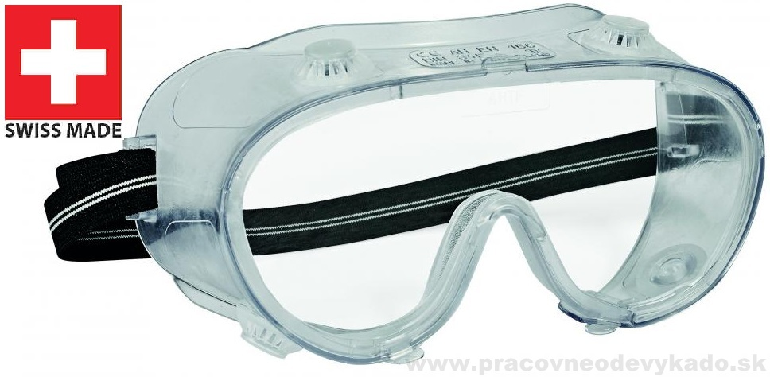
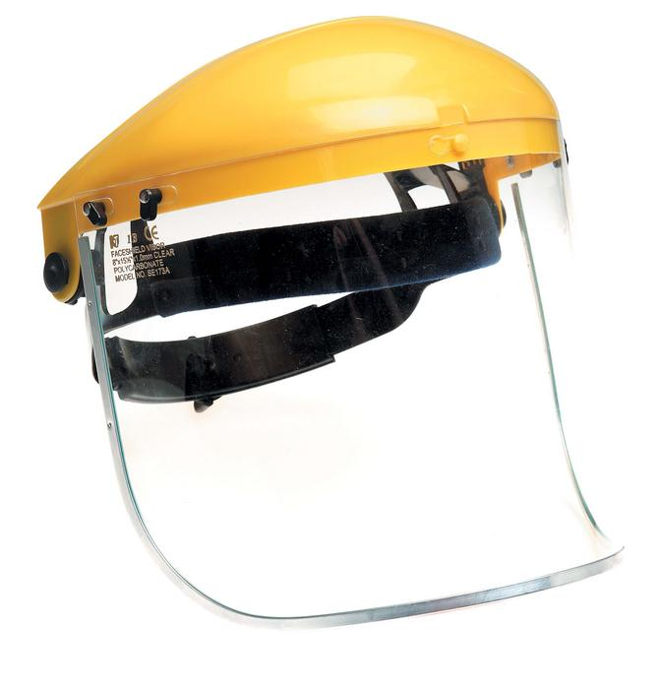
Protective measures when working with biological factors and GMOs
Disinfection
Príprava roztoku chlórnanu sodného
Pri práci používaj
a) from household preparations (small 1 liter packages) containing 5% NaClO, e.g. SAVO Original, diluted 10 times (0.5 %), or SAVO Prim, diluted 30 times (0.15 %),
b) from household preparations (small 1 liter packages) containing 5% NaClO, e.g. SAVO Original, diluted 10 times (0.5 %), or SAVO Prim, diluted 30 times (0.15 %), (0,15 %),
Warning
- Diluted NaClO solutions degrease the skin and therefore must not be used for washing and disinfecting hands.
- Good ventilation must be ensured in the room with NaClO
- When mixed with acids, poisonous chlorine is released.

Slide 39
Protective measures when working with biological factors and GMOs
Sterilization and its control
Sterilization is the killing of all forms of microorganisms, including bacterial spores, on the surface of objects or in the environment
Sterility of objects is achieved by physical and chemical sterilization procedures.
Physical sterilization
- moist heat sterilization - is sterilization with saturated water vapor without the presence of air and is carried out under increased pressure in steam sterilizers - autoclaves (metal, rubber, glass, textiles, porcelain, ceramics).
- by circulating hot air (objects made of metal, glass, porcelain, ceramics and earthenware) - It is performed in hot air sterilizers with forced air circulation at the following parameters (their combinations):
a) 160 °C for 60 min, b) 170 °C for 30 min, c) 180 °C for 20 min
- plasma sterilization - uses plasma created in a high-frequency electromagnetic field from hydrogen peroxide or other chemical substances. It is not used for the sterilization of porous and absorbent material and material made of cellulose.

Slide 40
Protective measures when working with biological factors and GMOs
Sterilization and its control
Chemical sterilization
Is a process in which the sterilization medium is a gas, e.g. formaldehyde or ethylene oxide. Sterilization takes place in devices at a specified vacuum or overpressure at a temperature of up to 80 °C.
As a rule, tools are inserted into sterilization devices wrapped.
The wrap is
a) primary (unitary), which is a sealed or closed system, creating a microbial barrier for the packaged object. It is equipped with a chemical indicator and can be disposable (paper, polyamide) or used repeatedly (metal cases for glass pipettes).ný chemickým indikátorom a môže byť jednorazový (papierový, polyamidový) alebo používaný opakovane (kovové puzdrá na sklené pipety).
b) secondary, which contains one or more objects packed in the primary packaging.

Slide 41
Protective measures when working with biological factors and GMOs
Sterilization and its control
The label on the package contains the date of sterilization, the date corresponding to the period during which the object is sterile, the method of sterilization and, in the case of opaque packaging, a description of the device.
The sterile object is transported to the place of use in a transport package in such a way that it is protected from contamination and damage.
It is stored in such a way that it does not become wet, dusty or mechanically damaged.
Sterilization control
It is performed by monitoring the sterilization cycle with biological, chemical and physical systems and sterility testing.

Slide 42
Protective measures when working with biological factors and GMOs
Health surveillance at work
The employer is obliged to ensure adequate health surveillance of employees during work that involves exposure to biological factors. Health surveillance is carried out in accordance with § 15 of the SR Government Regulation No. 83/2013 Coll. on protecting the health of employees from risks related to exposure to biological factors at work.
Health surveillance must be provided before exposure and at regular intervals during exposure
Medical preventive examinations (LPP) in connection with the performance of work are carried out on the basis of § 31 of Act no. 355/2007 Coll. and according to the classification of works from the point of view of health risks based on the decree of the Ministry of Health of the Slovak Republic no. 448/2007 Coll., once every 2 years for an employee, if he performs work included in the 3rd category of work.

Slide 43
Protective measures when working with biological factors and GMOs
Health surveillance at work
In the 3rd category of risky work in VI BMC SAS, work is included in which employees are exposed to a biological factor of the 3rd group, if the infections caused by them are spread through the air under normal conditions.
The 2nd category of work includes activities in which employees are exposed to biological factors
2nd group or
3rd group, if the infections caused by them do not spread through the air under normal conditions (designation 3**).

Slide 44
Protective measures when working with biological factors and GMOs
Health surveillance at work
Medical preventive examinations in relation to work are carried out by doctors of the occupational health service (PZS). For work classified in the 1st or 2nd category, LPP can be performed, in addition to PZS doctors, by doctors specializing in the field of general medicine who are not doctors of the occupational health service.
Employees who are or may be exposed to a biological agent to which they are not immune shall be vaccinated by the employer, provided that an effective vaccine is available. Based on the risk assessment, the employee responsible for health and safety together with the manager of the relevant employee will decide on the need for vaccination.

Slide 45
Protective measures when working with biological factors and GMOs
Informing and training of employees

Slide 46
Protective measures when working with biological factors and GMOs
Informing and training of employees
Notification and training of employees on safety and health protection at work is carried out in accordance with § 7 of Act no. 124/2006 Coll. and according to § 10 of the Slovak Government Regulation no. 83/2013 Coll.
The employer is obliged to regularly, comprehensibly and demonstrably inform each employee:
a) with regulations to ensure health and safety and verify their knowledge,
b) with occurring and foreseeable dangers, their effects on health and protection against them.

Slide 47
Protective measures when working with biological factors and GMOs
Informing and training of employees
During the knowledge verification, the employee is required to know:
a) classification of biological factors according to Slovak government regulation no. 83/2013 Coll.,
b) information on infectious diseases that may arise in connection with the performance of work at the employee's workplace,
c) protective measures when working with biological factors and GMOs used or likely to occur at the employee's workplace,
d) disinfection and sterilization methods related to the employee's workplace,
e) principles of first aid, procedure in the event of an emergency related to biological factors,
f) rules for handling contaminated waste.
Repeated training of employees and senior staff on safety and health protection when working with biological factors and GMOs is carried out in the organization at least once a year.

Slide 48
Protective measures when working with biological factors and GMOs
Informing and training of employees
Employees immediately report any extraordinary event associated with the handling of biological factors to their senior employee (head of department or laboratory) and, depending on the severity, to other persons listed in the Emergency Plan for the Protection of Employees from Exposure to Biological Factors
Employees immediately report any extraordinary event related to the handling of GMOs to their senior employee (head of department or laboratory) and the head of the GMO project, depending on the severity, also to the chairman of the Safety Committee of BMC SAS and other persons listed in the Operating Regulations of laboratories intended for working with GMOs and in the Emergency Plans for activities classified in risk class 2 (published on the BMC SAS website).

Slide 49
Protective measures when working with biological factors and GMOs
Cleaning and laundry
Cleaning - removing dirt and reducing the number of microorganisms in the work environment.
- It is carried out wet in all premises of the organization and in every workplace with washable floors and immediately after accidental contamination.
Infectious and devices for personal hygiene - cleaning and disinfecting preparations with a minimal antibacterial and virucidal effect are used.
Common areas - cleaning using detergents is sufficient

Slide 50
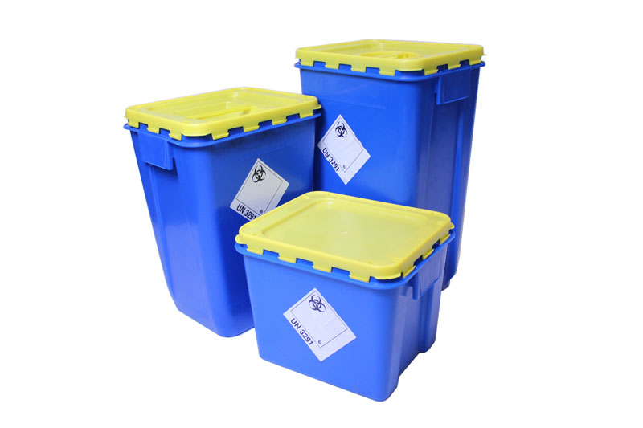
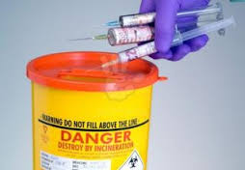
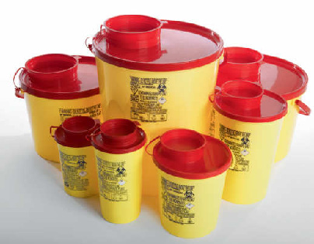
Management of waste contaminated with biological factors and GMOs

Slide 51
Management of waste contaminated with biological factors and GMOs
I. Liquid contaminated waste (microbial cultures, used culture media)
Concentrated 15% sodium hypochlorite is added to the waste with a larger volume to 0.5% of the final concentration (dilution 1:30); after 30-60 minutes, the waste is poured into the sink.
Waste is thermally disposed of in a steam sterilizer, namely in an autoclave at 121 °C (pressure 200 kPa) for 20 min or in a pressure cooker (cooker) at 113-116 °C (pressure approx. 160-180 kPa) for 30 min ; after the stated sterilization time and the device has cooled down, the waste is poured into the sink.
Waste with a small volume and generated in plastic closable tubes (e.g. in Eppendorf tubes) is transferred in plastic bags (containers) to the waste collection room and then to the general room reserved for veterinary and medical waste in the VI BMC Zoo.
Waste removal and disposal will be provided by the medical waste incinerator of the Bratislava University Hospital (Petržalka workplace).

Slide 52
Management of waste contaminated with biological factors and GMOs
II. Solid contaminated waste (plastic and rubber items)
are stored (discarded) at workplaces:
into containers containing a disinfectant solution; after decontamination, small objects are rinsed with water and placed in plastic bags, or
into marked, washable and resealable containers containing an inserted plastic bag, or
in disposable plastic containers with a lid (e.g. Klinik box type); Depending on the nature of the waste, containers are kept in a refrigerator or freezer until disposal.
After filling and closing the bag, or containers with a lid, these are marked with the name of the organizational unit, the name of the responsible worker and are placed in reserved rooms according to the biological factors present. The waste is further handled as in point I.c,
Waste and contaminated items from BSL 3 laboratories are decontaminated on site in an autoclave at 121 °C (point I.b.) and further disposed of as in point I.c.

Slide 53
Management of waste contaminated with biological factors and GMOs
III. Dead experimental animals and their carcasses after necropsy
Zoo employees put dead animals and their carcasses in plastic bags. The bags are closed and placed in the refrigerator or freezer in the room reserved for veterinary and medical waste in the VI BMC Zoo. Waste removal and disposal will be provided by the medical waste incinerator of the Bratislava University Hospital (Petržalka workplace).
IV. Waste from infected eggs
Waste is placed in double plastic bags, which are placed in marked, washable and closable containers or in disposable plastic containers with lids (e.g. Klinik box type). Containers with waste are stored in the refrigerator or freezer for a short time at the workplace.
If the waste contains biol. group 3 factors (e.g. Coxiella burnetii), must be stored in a cooling device or in a room that is locked.
After filling the containers, or after the work is completed, the containers with waste are closed and marked with the name of the organizational unit, the name of the responsible worker. They will then be transported to a full-scale room reserved for veterinary and medical waste in the VI BMC Zoo, where they will be temporarily stored in a refrigerator or freezer. They are then dealt with as in point I.c.

Slide 54
Management of waste contaminated with biological factors and GMOs
V. Medical sharps and contaminated instruments
Sharp objects, such as injection needles, scalpel blades, small pieces of glass are stored in dedicated, strong, sealable and combustible plastic containers. In this case, the injection needles are not removed from the syringes, they are not put on the protective covers and they are put into the plastic containers as a whole. After being filled and reliably closed, the containers are marked with the name of the workplace, the name of the responsible worker and the name of the biological factor and are placed in designated rooms according to the biological factors present:
2nd group of biol. factors → to the waste collection room, from where the employees of the Technical Department will transport it to the whole building room reserved for veterinary and medical waste in the VI BMC Zoo; the waste is further treated as in point I.c,
3rd group of biol. factors → in a disposable plastic container with a lid (e.g. Klinik box type) it is transferred to the all-institutional room reserved for veterinary and medical waste in the V Zoo; the waste is further handled as in point I.c.
Waste and contaminated objects (dissection instruments) from BSL 3 laboratories are decontaminated on site in an autoclave at 121 °C (point I.b.). They are then dealt with as in point I.c. or they are cleaned and prepared for further use.

Slide 55
Management of waste contaminated with biological factors and GMOs
VI. Contaminated laboratory glass
Glass objects (pipettes, test tubes, beakers, flasks) contaminated with biological factors are first decontaminated by immersing them in a 0.5% sodium hypochlorite solution or another disinfectant for 30-60 minutes. Next, they are rinsed with water, the liquid is removed and, depending on the type of glass, they are disposed of as follows.
Undamaged items are washed, sterilized in washrooms and returned to use.
Damaged or disposable items (e.g. chipped, broken measuring pipettes, test tubes, flasks, glass Pasteur pipettes) are collected in dedicated cardboard boxes.
Authorized employees will ensure regular delivery of waste glass.

Slide 56
Organizational and technical measures for disposal of biol. factors and GMOs
In the event of a leak of infectious or potentially infectious biological factors, the first immediate measures to mitigate the consequences of an emergency are carried out by employees alone or under the supervision of a senior employee until the arrival of the leading response.
The management of the intervention in the event of an emergency of a larger scale is carried out by the employee responsible for health and safety with biological factors and, in his absence, by other authorized employees according to the table below (hereinafter the leader of the intervention).
Only employees who have been authorized to carry out decontamination, hygienic cleaning, repair or other corrective measures work temporarily in the affected area. They protect themselves from the effects of released biological factors with personal protective work equipment (protective clothing, shoes, gloves, protective glasses / face shield, respiratory protection).

Slide 57
Decontamination procedure
Disinfectant is not poured directly onto the spilled material to avoid creating an aerosol.
Spilled biological material is covered with paper wool or gauze. Disinfectant is poured onto the absorbent material in a circular motion from the edge to the center and left to act for 30-60 minutes.
As a rule, 0.5% sodium hypochlorite is used for decontamination
If metal surfaces are contaminated (laminar box, devices, instruments), other disinfectants are used (2% Desam GK, 2% Incidur, 1% Kvarsept 3 Gen, Desprej).
Small drops of bacterial and viral suspension or leaked cell cultures can be directly sprayed with alcohol-based spray preparations, e.g. Spray or Incidur spray.

Slide 58
Decontamination procedure
After the prescribed period of disinfection, the paper wool and gauze, together with the solid remains of the biological material, are collected in a plastic bag. If the decontaminated waste also includes broken glass or other sharp waste (needles with syringes), the waste is collected using pieces of cardboard or tweezers into a plastic container with solid walls and a lid. Decontaminated waste is autoclaved at 121°C for 20 minutes and then incinerated.
The affected area, free of solid dirt, is wiped once again with a disinfectant and washed in the classic way. Upon completion of work, authorized employees will notify their supervisor and the employee responsible for health and safety with biological factors that the area or equipment has been decontaminated. The employee responsible for health and safety with biological factors will record the extraordinary event.

Slide 59
Thanks for Your attention!
Informations:
Csaba Kósa, PhD.,
Csaba.Kosa@savba.sk

