Slide 1
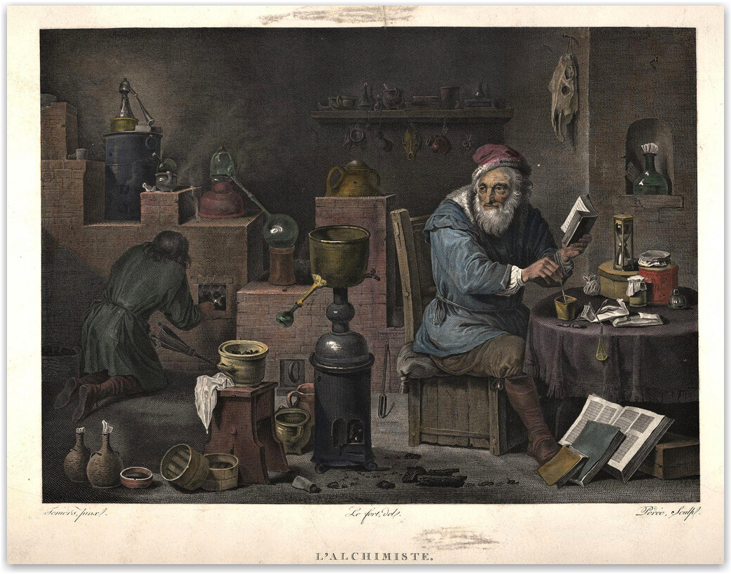
Education training for employees working
with hazardous chemicals
Csaba Kósa, PhD.

Slide 2


Slide 3
Content:
Introduction
Related legislative and other documents
Classification and labelling of hazardous chemicals
- According to physical properties
- According to health hazard
- According to environmental hazard
Packaging of chemicals, labelling and MSDS cards
Safety and health protection at work with hazardous chemicals
- Protection of employees before the risks related from expositions with hazardous chemicals at work (Regulation of the Government of the Slovak Republic 355/2006 Coll.); Protection of employees before the risks related from expositions with carcinogens, mutagens or reproductively toxic factors at work (Regulation of the Government of the Slovak Republic 121/2024 Coll.)
- Operating Rules for work with hazardous chemicals

Slide 4

Introduction
Related legislative and other documents
EU legislative
Regulation (EC) No 1272/2008 on classification, labelling and packaging of substances and mixtures (CLP / GHS)
Slovak national legislative
- Zákon NR SR č. 67/2010 Z.z. o podmienkach uvedenia chemických látok a chemických zmesí na trh a o zmene a doplnení niektorých zákonov (chemický zákon). (Law for specifications of introduction of hazardous chemicals to the market)
- Zákon NR SR č. 355/2007 Zz. o ochrane, podpore a rozvoji verejného zdravia a o zmene a doplnení niektorých zákonov (Act No 355/2007 Coll. on Protection, Support and Development of Public Health and on Amendments and Supplements to Certain Acts )

Slide 5
Introduction
Related legislative and other documents
Slovak national legislative
- Nariadenie vlády SR č. 355/2006 Zz. o ochrane zamestnancov pred rizikami súvisiacimi s expozíciou chemickým faktorom pri práci v znení neskorších predpisov. (Regulation of the Government of the Slovak Republic 355/2006 Coll.: Protection of employees before the risks related from expositions with hazardous chemicals at work.)
- Nariadenie vlády 121/2024 Z.z. o ochrane zdravia zamestnancov pred rizikami súvisiacimi s expozíciou karcinogénnym faktorom, mutagénnym faktorom alebo reprodukčne toxickým faktorom pri práci v znení neskorších predpisov. (Regulation of the Government of the Slovak Republic 121/2024 Coll.: Protection of employees before the risks related from expositions with carcinogens, mutagens or reproductively toxic factors at work )
- STN EN 01 8003 Zásady bezpečnosti práce v chemických laboratóriách (Principles of safety work at chemical laboratory)
ON 910971 Digestory pre chemické laboratóriá (digestors for chemical laboratories)
STN EN 14175-1 (83 3820) Odsávacie boxy. (Fume cup-boards.)

Slide 6
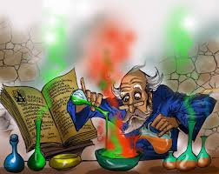
Introduction
Sources of accidents and risks at work in chemical laboratory
Hazardous chemicals
Used bowls, apparatus, laboratory equipments and other tools

Slide 7

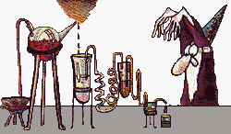

Introduction
How to prevent injuries and risks at work in chemical laboratory
By knowledge of properties of used hazardous chemicals, respecting the rules of their correct storage and safety utilization.
Respecting the correct operation procedures and principles of safety work in chemical laboratory

Slide 8
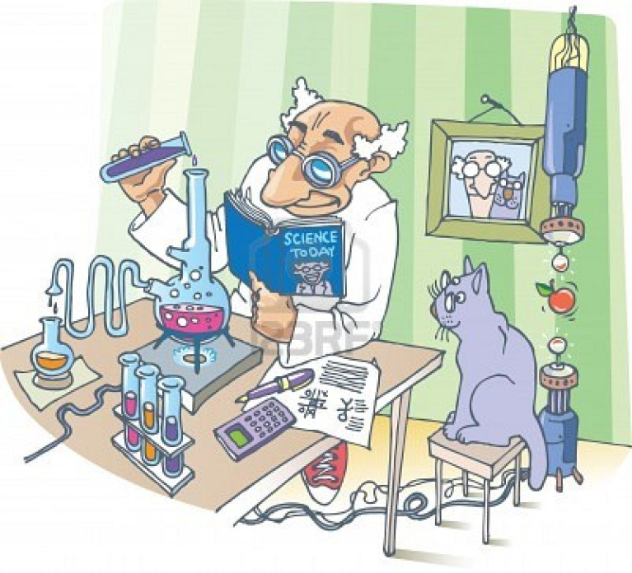
Introduction
Internal documents:
„Rules of safety and health protection at work with hazardous chemicals“
„Operating rules for work with hazardous chemicals“

Slide 9
Content:
Introduction
Related legislative and other documents
Classification and labelling of hazardous chemicals
- According to physical properties
- According to health hazard
- According to environmental hazard
Packaging of chemicals, labelling and MSDS cards
Safety and health protection at work with hazardous chemicals
- Protection of employees before the risks related from expositions with hazardous chemicals at work (Regulation of the Government of the Slovak Republic 355/2006 Coll.); Protection of employees before the risks related from expositions with carcinogens, mutagens or reproductively toxic factors at work (Regulation of the Government of the Slovak Republic 121/2024 Coll.)
- Operating Rules for work with hazardous chemicals

Slide 10





Slide 11





Classification and labelling of hazardous chemicals
New system for classification and labeling
of chemicals - CLP / GHS
- According to physical properties
Flammable liquids
Flammable solids
Explosives
Pyrophoric liquids
Pyrophoric solids
Selfheating substances and mixtures
Flammable gases
Substances and mixtures which in contact with water, emit flammable gases
Gases under pressure
Selfreactive substances and mixtures

Slide 12



Classification and labelling of hazardous chemicals
New system for classification and labeling
of chemicals - CLP / GHS
- According to physical properties
Oxidizing liquids
Corrosive to metals
Oxidizing solids
Organic peroxides

Slide 13




Classification and labelling of hazardous chemicals
New system for classification and labelling
of chemicals - CLP / GHS
- According to the health hazard
Reproductive toxicity
Acute toxicity
- oral toxicity
- dermal toxicity
- inhalation toxicity
Germ cell mutagenicity
Carcinogenicity
Specific target organ toxicity (STOT)
single exposure/repeated exposure
Skin corrosion/irritation
Aspiration hazard
Serious eye damage/eye irritation
- According to environmental hazard
Hazardous to the aquatic
environment
Respiratory or skin sensitization

Slide 14
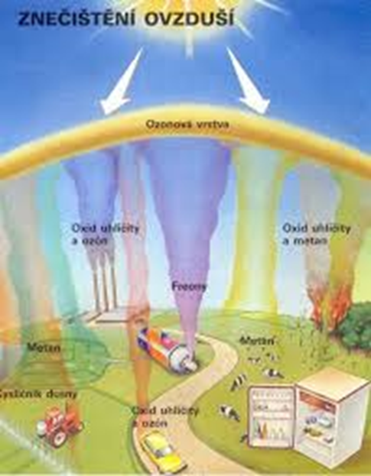
New system for classification and labelling of chemicals - CLP / GHS
Specific class of chemicals according to the CLP / GHS classification represent the chemicals „Hazardous to the ozone layer“
Ozone Depleting Potential (ODP) is an integrative quantity, distinct for each halocarbon source species, that represents the extent of ozone depletion in the stratosphere expected from the halocarbon on a mass-for-mass basis relative to CFC-11. The formal definition of ODP is the ratio of integrated perturbations to total ozone, for a differential mass emission of a particular compound relative to an equal emission of CFC-11.

Slide 15
Content:
Introduction
Related legislative and other documents
Classification and labelling of hazardous chemicals
- According to physical properties
- According to health hazard
- According to environmental hazard
Packaging of chemicals, labelling and MSDS cards
Safety and health protection at work with hazardous chemicals
- Protection of employees before the risks related from expositions with hazardous chemicals at work (Regulation of the Government of the Slovak Republic 355/2006 Coll.); Protection of employees before the risks related from expositions with carcinogens, mutagens or reproductively toxic factors at work (Regulation of the Government of the Slovak Republic 121/2024 Coll.)
- Operating Rules for work with hazardous chemicals

Slide 16
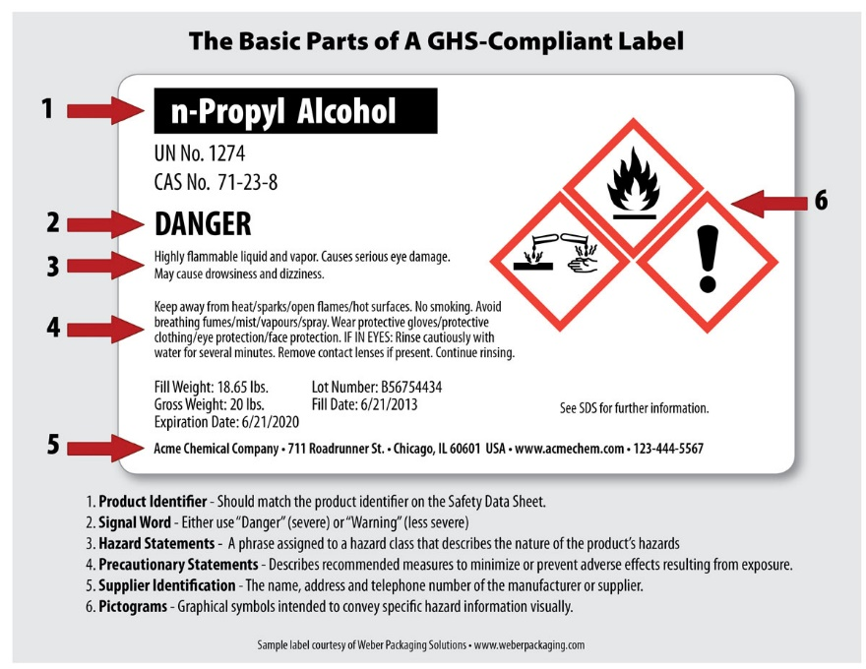
Packaging of chemicals, labelling and Material safety data sheet (MSDS)
Supplier of hazardous chemicals should provide packing for distribution sufficiently consistent to the weight, physical-chemical properties of the content, to avoid its leaking or decomposition. Labelling should give enough information for safety transport, storage and utilization.
https://www.whitlam.com/wp-content/uploads/2013/10/Weber-Epson-Sample-CLP / GHS-label-n-propyl.jpg

Slide 17
Packaging of chemicals, labelling and MSDS cards
Supplier of hazardous substances and mixtures should present to receiver the MSDS cards in printed or electronic form at least on the day of first time delivery in official language of the country!!!
The information in the MSDS should be presented using the following 16 headings:
1. Identification
2. Hazard(s) identification
3. Composition/information on ingredients
4. First-aid measures
5. Fire-fighting measures
6. Accidental release measures
7. Handling and storage
8. Exposure controls/personal protection
9. Physical and chemical properties and safety characteristics
10. Stability and reactivity
11. Toxicological information
12. Ecological information
13. Disposal considerations
14. Transport information
15. Regulatory information
16. Other information

Slide 18
Packaging of chemicals, labelling and MSDS cards
Important informations on the package of hazardous chemicals and in MSDS cards are the Hazard statement codes for physical, health and environmental hazards (H-codes), other hazard statement codes for EU (EUH-codes) and Codification of precautionary statements (P-codes).
1. Part 1: Hazard statement codes for physical hazards
H200: Unstable explosive
H201: Explosive; mass explosion hazard
H202: Explosive; severe projection hazard
H203: Explosive; fire, blast or projection hazard
H204: Fire or projection hazard
H205: May mass explode in fire
H206: Fire, blast or projection hazard; increased risk of explosion if desensitizing agent is reduced
H207: Fire or projection hazard; increased risk of explosion if desensitizing agent is reduced
H208: Fire hazard; increased risk of explosion if desensitizing agent is reduced
H220: Extremely flammable gas
H221: Flammable gas
H222: Extremely flammable aerosol
H223: Flammable aerosol

Slide 19
Packaging of chemicals, labelling and MSDS cards
1. Part 1: Hazard statement codes for physical hazards
H224: Extremely flammable liquid and vapour
H225: Highly flammable liquid and vapour
H226: Flammable liquid and vapour
H227: Combustible liquid
H228: Flammable solid
H229: Pressurized container: may burst if heated
H230: May react explosively even in the absence of air
H231: May react explosively even in the absence of air at elevated pressure and/or temperature
H232: May ignite spontaneously if exposed to air
H240: Heating may cause an explosion
H241: Heating may cause a fire or explosion
H242: Heating may cause a fire
H250: Catches fire spontaneously if exposed to air
H251: Self-heating; may catch fire
H252: Self-heating in large quantities; may catch fire
H260: In contact with water releases flammable gases which may ignite spontaneously

Slide 20
Packaging of chemicals, labelling and MSDS cards
1. Part 1: Hazard statement codes for physical hazards
H261: In contact with water releases flammable gas
H270: May cause or intensify fire; oxidizer
H271: May cause fire or explosion; strong oxidizer
H272: May intensify fire; oxidizer
H280: Contains gas under pressure; may explode if heated
H281: Contains refrigerated gas; may cause cryogenic burns or injury
H290: May be corrosive to metals

Slide 21
Packaging of chemicals, labelling and MSDS cards
Part 2: Hazard statement codes for health hazards
H300: Fatal if swallowed
H301: Toxic if swallowed
H302: Harmful if swallowed
H303: May be harmful if swallowed
H304: May be fatal if swallowed and enters airways
H305: May be harmful if swallowed and enters airways
H310: Fatal in contact with skin
H311: Toxic in contact with skin
H312: Harmful in contact with skin
H313: May be harmful in contact with skin
H314: Causes severe skin burns and eye damage
H315: Causes skin irritation
H316: Causes mild skin irritation
H317: May cause an allergic skin reaction
H318: Causes serious eye damage
H319: Causes serious eye irritation
H320: Causes eye irritation

Slide 22
Packaging of chemicals, labelling and MSDS cards
1. Part 2: Hazard statement codes for health hazards
H330: Fatal if inhaled
H331: Toxic if inhaled
H332: Harmful if inhaled
H333: May be harmful if inhaled
H334: May cause allergy or asthma symptoms or breathing difficulties if inhaled
H335: May cause respiratory irritation
H336: May cause drowsiness or dizziness
H340: May cause genetic defects
H341: Suspected of causing genetic defects
H350: May cause cancer
H351: Suspected of causing cancer
H360: May damage fertility or the unborn child
H361: Suspected of damaging fertility or the unborn child
H361d: Suspected of damaging the unborn child
H362: May cause harm to breast-fed children
H370: Causes damage to organs
H371: May cause damage to organs
H372: Causes damage to organs through prolonged or repeated exposure
H373: May cause damage to organs through prolonged or repeated exposure

Slide 23
Packaging of chemicals, labelling and MSDS cards
Part 3: Hazard statement codes for environmental hazards
H400: Very toxic to aquatic life
H401: Toxic to aquatic life
H402: Harmful to aquatic life
H410: Very toxic to aquatic life with long-lasting effects
H411: Toxic to aquatic life with long-lasting effects
H412: Harmful to aquatic life with long-lasting effects
H413: May cause long-lasting harmful effects to aquatic life
H420: Harms public health and the environment by destroying ozone in the upper atmosphere

Slide 24
Packaging of chemicals, labelling and MSDS cards
2. Other hazard statement codes for EU (EUH)
Physical properties
EUH001: Explosive when dry
EUH006: Explosive with or without contact with air, deleted in the fourth adaptation to technical progress of CLP.
EUH014: Reacts violently with water
EUH018: In use may form flammable/explosive vapour-air mixture
EUH019: May form explosive peroxides
EUH044: Risk of explosion if heated under confinement
Health properties
EUH029: Contact with water liberates toxic gas
EUH031: Contact with acids liberates toxic gas
EUH032: Contact with acids liberates very toxic gas
EUH066: Repeated exposure may cause skin dryness or cracking
EUH070: Toxic by eye contact
EUH071: Corrosive to the respiratory tract
Environmental properties
EUH059: Hazardous to the ozone layer, superseded by CLP / GHS Class 5.1 in the second adaptation to technical progress of CLP.

Slide 25
Packaging of chemicals, labelling and MSDS cards
2. Other hazard statement codes for EU(EUH)
EUH201: Contains lead. Should not be used on surfaces liable to be chewed or sucked by children.
EUH201A: Warning! Contains lead.
EUH202: Cyanoacrylate. Danger. Bonds skin and eyes in seconds. Keep out of the reach of children.
EUH203: Contains chromium(VI). May produce an allergic reaction.
EUH204: Contains isocyanates. May produce an allergic reaction.
EUH205: Contains epoxy constituents. May produce an allergic reaction.
EUH206: Warning! Do not use together with other products. May release dangerous gases (chlorine).
EUH207: Warning! Contains cadmium. Dangerous fumes are formed during use. See information supplied by the manufacturer. Comply with the safety instructions.
EUH208: Contains <name of sensitising substance>. May produce an allergic reaction.
EUH209: Can become highly flammable in use.
EUH209A: Can become flammable in use.
EUH210: Safety data sheet available on request.
EUH401: To avoid risks to human health and the environment, comply with the instructions for use.0

Slide 26
Packaging of chemicals, labelling and MSDS cards
Codification of precautionary statements
General precautionary statements
P101: If medical advice is needed, have product container or label at hand.
P102: Keep out of reach of children.
P103: Read label before use.
Prevention precautionary statements
P201: Obtain special instructions before use.
P202: Do not handle until all safety precautions have been read and understood.
P210: Keep away from heat, hot surfaces, sparks, open flames and other ignition sources. No smoking.
P211: Do not spray on an open flame or other ignition source.
P220: Keep/Store away from clothing/.../combustible materials.
P221: Take any precaution to avoid mixing with combustibles.
P222: Do not allow contact with air.
P223: Do not allow contact with water.
P230: Keep wetted with ...

Slide 27
Packaging of chemicals, labelling and MSDS cards
Prevention precautionary statements
P231: Handle under inert gas.
P232: Protect from moisture.
P233: Keep container tightly closed.
P234: Keep only in original container.
P235: Keep cool..
P240: Ground/bond container and receiving equipment.
P241: Use explosion-proof electrical/ventilating/lighting/.../equipment.
P242: Use only non-sparking tools.
P243: Take precautionary measures against static discharge.
P244: Keep valves and fittings free from oil and grease.
P250: Do not subject to grinding/shock/.../friction.
P251: Do not pierce or burn, even after use.
P260: Do not breathe dust/fumes/gas/mist/vapours/spray.
P261: Avoid breathing dust/fumes/gas/mist/vapours/spray
P262: Do not get in eyes, on skin, or on clothing.
P263: Avoid contact during pregnancy/while nursing.
P264: Wash ... thoroughly after handling.

Slide 28
Packaging of chemicals, labelling and MSDS cards
Prevention precautionary statements
P270: Do not eat, drink or smoke when using this product.
P271: Use only outdoors or in a well-ventilated area.
P272: Contaminated work clothing should not be allowed out of the workplace.
P273: Avoid release to the environment.
P280: Wear protective gloves/protective clothing/eye protection/face protection.
P282: Wear cold insulating gloves/face shield/eye protection.
P283: Wear fire/flame resistant/retardant clothing.
P284: In case of inadequate ventilation wear respiratory protection
P231+232: Handle under inert gas. Protect from moisture
P235+410: Keep cool. Protect from sunlight

Slide 29
Packaging of chemicals, labelling and MSDS cards
Response precautionary statements
P301: IF SWALLOWED:
P302: IF ON SKIN:
P303: IF ON SKIN (or hair):
P304: IF INHALED:
P305: IF IN EYES:
P306: IF ON CLOTHING:
P307: [Deleted by IV ATP]
P308: If exposed or concerned:
P309: [Deleted by IV ATP]
P310: Immediately call a NATIONAL TOXICOLOGICAL INFORMATION CENTRE/doctor/...
P311: Call a NATIONAL TOXICOLOGICAL INFORMATION CENTRE/doctor/...
P312: Call a NATIONAL TOXICOLOGICAL INFORMATION CENTRE/doctor/.../if you feel unwell.
P313: Get medical advice/attention.
P314: Get medical advice/attention if you feel unwell.
P315: Get immediate medical advice/attention.
P320: Specific treatment is urgent (see ... on this label).

Slide 30
Packaging of chemicals, labelling and MSDS cards
Response precautionary statements
P321: Specific treatment (see ... on this label).
P330: Rinse mouth.
P331: Do NOT induce vomiting.
P332: If skin irritation occurs:
P333: If skin irritation or a rash occurs:
P334: Immerse in cool water/wrap in wet bandages.
P335: Brush off loose particles from skin.
P336: Thaw frosted parts with lukewarm water. Do not rub affected areas.
P337: If eye irritation persists:
P338: Remove contact lenses if present and easy to do. Continue rinsing.
P340: Remove person to fresh air and keep comfortable for breathing.
P342: If experiencing respiratory symptoms:

Slide 31
Packaging of chemicals, labelling and MSDS cards
Response precautionary statements
P351: Rinse cautiously with water for several minutes.
P352: Wash with plenty of water/...
P353: Rinse skin with water/shower.
P360: Rinse immediately contaminated clothing and skin with plenty of water before removing clothes.
P361: Take off immediately all contaminated clothing.
P362: Take off contaminated clothing.
P363: Wash contaminated clothing before reuse.
P364: And wash it before reuse.
P370: In case of fire:
P371: In case of major fire and large quantities:
P372: Explosion risk in case of fire.
P373: DO NOT fight fire when fire reaches explosives.
P374: Fight fire with normal precautions from a reasonable distance.
P375: Fight fire remotely due to the risk of explosion.

Slide 32
Packaging of chemicals, labelling and MSDS cards
Response precautionary statements
P376: Stop leak if safe to do so.
P377: Leaking gas fire –do not extinguish unless leak can be stopped safely.
P378: Use ... to extinguish.
P380: Evacuate area.
P381: Eliminate all ignition sources if safe to do so.
P391: Collect spillage.
P301+310: IF SWALLOWED: Immediately call a NATIONAL TOXICOLOGICAL INFORMATION CENTRE/doctor/...
P301+312: IF SWALLOWED: Call a NATIONAL TOXICOLOGICAL INFORMATION CENTRE/doctor/.../if you feel unwell.
P301+330+331: IF SWALLOWED: Rinse mouth. Do NOT induce vomiting.
P302+334: IF ON SKIN: Immerse in cool water/wrap in wet bandages.
P302+352: IF ON SKIN: Wash with plenty of water/...
P303+361+353: IF ON SKIN (or hair): Take off immediately all contaminated clothing. Rinse skin with water/shower.
P304+312: IF INHALED: Call a NATIONAL TOXICOLOGICAL INFORMATION CENTRE or doctor/physician if you feel unwell.

Slide 33
Packaging of chemicals, labeling the cover and MSDS cards
Response precautionary statements
P304+340: IF INHALED: Remove person to fresh air and keep comfortable for breathing. P305+351+338: IF IN EYES: Rinse cautiously with water for several minutes. Remove contact lenses if present and easy to do – continue rinsing.
P306+360: IF ON CLOTHING: Rinse immediately contaminated clothing and skin with plenty of water before removing clothes.
P308+311: If exposed or concerned: Call a NATIONAL TOXICOLOGICAL INFORMATION CENTRE/ doctor/...
P308+313: If exposed: Call a NATIONAL TOXICOLOGICAL INFORMATION CENTRE or doctor/physician.
P332+313: If skin irritation occurs: Get medical advice/attention.
P333+313: If skin irritation or a rash occurs: Get medical advice/attention.
P335+334: Brush off loose particles from skin. Immerse in cool water/wrap in wet bandages.
P337+313: If eye irritation persists get medical advice/attention.
P342+311: If experiencing respiratory symptoms: Call a NATIONAL TOXICOLOGICAL INFORMATION CENTRE /doctor/...

Slide 34
Packaging of chemicals, labelling and MSDS cards
Response precautionary statements
P361+364: Take off immediately all contaminated clothing and wash it before reuse. P362+364: Take off contaminated clothing and wash it before reuse.
P370+376: In case of fire: Stop leak if safe to do so.
P370+378: In caseof fire: Use ... to extinguish.
P370+380: In case of fire: Evacuate area.
P370+380+375: In case of fire: Evacuate area. Fight fire remotely due to the risk of explosion.
P371+380+375: In case of major fire and large quantities: Evacuate area. Fight fire remotely due to the risk of explosion.

Slide 35
Packaging of chemicals, labelling and MSDS cards
Storage precautionary statements
P401: Store ...
P402: Store in a dry place.
P403: Store in a well ventilated place.
P404: Store in a closed container.
P405: Store locked up.
P406: Store in a corrosive resistant/... container with a resistant inner liner.
P407: Maintain air gap between stacks/pallets.
P410: Protect from sunlight.
P411: Store at temperatures not exceeding ... °C/... °F.
P412: Do not expose to temperatures exceeding 50°C/122°F
P413: Store bulk masses greater than ... kg/... lbs at temperatures not exceeding ... °C/... °F.
P420: Store away from other materials.
P422: Store contents under ...

Slide 36
Packaging of chemicals, labelling and MSDS cards
Storage precautionary statements
P402+404: Store in a dry place. Store in a closed container.
P403+233: Store in a well ventilated place. Keep container tightly closed
P403+235: Store in a well ventilated place. Keep cool.
P410+403: Protect from sunlight. Store in a well-ventilated place.
P410+412: Protect from sunlight. Do not expose to temperatures exceeding 50°C/122°F.
P411+235: Store at temperatures not exceeding ... °C/... °F. Keep cool.
Disposal precautionary statements
P501: Dispose of contents/container to ... [... in accordance wit local/regional/national/international regulation (to be specified)]

Slide 37
Content:
Introduction
Related legislative and other documents
Classification and labelling of hazardous chemicals
- According to physical properties
- According to health hazard
- According to environmental hazard
Packaging of chemicals, labelling and MSDS cards
Safety and health protection at work with hazardous chemicals
- Protection of employees before the risks related from expositions with hazardous chemicals at work (Regulation of the Government of the Slovak Republic 355/2006 Coll.); Protection of employees before the risks related from expositions with carcinogens, mutagens or reproductively toxic factors at work (Regulation of the Government of the Slovak Republic 121/2024 Coll.)
- Operating Rules for work with hazardous chemicals

Slide 38


Safety and health protection at work with hazardous chemicals
Protection of workers from the risks related to exposure to chemical agents at work, as amended (Regulation of the Government of the Slovak Republic 355/2006 Coll.); protection of workers from the risks related to exposure to carcinogens, mutagens or reproductively toxic factors at work, as amended (Regulation of the Government of the Slovak Republic 121/2024 Coll.)
Employer's obligation
Dangerous chemicals, carcinogens, mutagens, reproductively toxic factors
YES
1. Assesment of risk
2. Prepare a risk assessment
3. Specific protective and preventive measures to eliminate the risk

Slide 39
Safety and health protection at work with hazardous chemicals
Regulation of the Government of the Slovak Republic 355/2006 Coll.; Regulation of the Government of the Slovak Republic 121/2024 Coll.
Risk assessment of exposure to carcinogenic factor, mutagenic factor or reproductively toxic factor
In the case of any activity likely to involve a risk of exposure to carcinogens, mutagens or reproductively toxic factors, the nature, degree and duration of workers‚ exposure shall be determined in order to make it possible to assess any risk to the workers' health or safety and to lay down the measures to be taken.
The assessment shall be renewed regularly and in any event when any change occurs in the conditions which may affect workers' exposure to carcinogens, mutagens or reproductively toxic factors.
When assessing the risk, account shall be taken of all other routes of exposure, such as absorption into and/or through the skin.
Carcinogens, mutagens or reproductively toxic factors can only be operated by persons who are 18 years of age or older.
Pregnant women, mothers by the end of the ninth month after delivery and breastfeeding women must not work with carcinogens, mutagens or reproductively toxic factors.

Slide 40
Safety and health protection at work with hazardous chemicals
Regulation of the Government of the Slovak Republic 355/2006 Coll.; Regulation of the Government of the Slovak Republic 121/2024 Coll.
General principles of risk prevention
Risks to the health and safety of workers at work involving hazardous chemical agents shall be eliminated or reduced to a minimum by:
the design and organisation of systems of work at the workplace;
the provision of suitable equipment for work with chemical agents and maintenance procedures which ensure the health and safety of workers at work;
(c) reducing to a minimum the number of workers exposed or likely to be exposed;
(d) reducing to a minimum the duration and intensity of exposure
(e) appropriate hygiene measures;

Slide 41
Safety and health protection at work with hazardous chemicals
Regulation of the Government of the Slovak Republic 355/2006 Coll.; Regulation of the Government of the Slovak Republic 121/2024 Coll.
General principles of risk prevention
(f) reducing the quantity of chemical agents present at the workplace to the minimum required for the type of work concerned
(g) suitable working procedures including arrangements for the safe handling, storage and transport within the workplace of hazardous chemical agents and waste containing such chemical agents.

Slide 42
Safety and health protection at work with hazardous chemicals
Regulation of the Government of the Slovak Republic 355/2006 Coll.; Regulation of the Government of the Slovak Republic 121/2024 Coll.
Specific protective and preventive measures
The employer shall ensure that the risk from a hazardous chemical agent to the safety and health of workers at work is eliminated or reduced to a minimum.
Substitution shall by preference be undertaken, whereby the employer shall avoid the use of a hazardous chemical agent by replacing it with a chemical agent or process which, under its condition of use, is not hazardous or less hazardous to workers' safety and health, as the case may be.

Slide 43
Safety and health protection at work with hazardous chemicals
Regulation of the Government of the Slovak Republic 355/2006 Coll.; Regulation of the Government of the Slovak Republic 121/2024 Coll.
Specific protective and preventive measures
Where the nature of the activity does not permit risk to be eliminated by substitution, having regard to the activity and risk assessment, the employer shall ensure that the risk is reduced to a minimum by application of protection and prevention measures, consistent with the assessment of the risk. These will include, in order of priority:
(a) design of appropriate work processes and engineering controls and use of adequate equipment and materials, so as to avoid or minimise the release of hazardous chemical agents which may present a risk to workers' safety and health at the place of work;
(b) application of collective protection measures at the source of the risk, such as adequate ventilation and appropriate organizational measures;
(c) where exposure cannot be prevented by other means, application of individual protection measures including personal protective equipment.

Slide 44
Safety and health protection at work with hazardous chemicals
Regulation of the Government of the Slovak Republic 355/2006 Coll.; Regulation of the Government of the Slovak Republic 121/2024 Coll.
Specific protective and preventive measures
(d) the inclusion of staff in management or autonomous work, if they have acquired competence to work with very toxic substances and mixtures and toxic substances and mixtures classified in hazard class:
  Category 1 and Category 2 acute toxicity with H300, H310, H330,
  Carcinogenicity, mutagenicity and reproductive toxicity categories 1A and 1B H340, H350 and H360
  Acute Category 3 Hazard Statements H301, H311, H331,
  Specific target organ toxicity (STOT) following single exposure to Category 1 with H370 warning.
On the basis of the overall assessment of and general principles for the prevention of risks, the employer shall take technical and/or organisational measures appropriate to the nature of the operation, including storage, handling and segregation of incompatible chemical agents, providing protection of workers against hazards arising from the physico-chemical properties of chemical agents.

Slide 45
Safety and health protection at work with hazardous chemicals
Regulation of the Government of the Slovak Republic 355/2006 Coll.; Regulation of the Government of the Slovak Republic 121/2024 Coll.
Measures to reduce exposure to carcinogens, mutagens or reproductively toxic factors
( 1) The employer shall reduce the use of a carcinogen, mutagen or reproductively toxic factor at the place of work, in particular by replacing it, in so far as is technically possible, by a substance, or process which, under its conditions of use, is not dangerous or is less dangerous to workers' health or safety, as the case may be
(2) Where it is not technically possible to replace the carcinogen, mutagen or reproductively toxic factor by a substance, or process which, under its conditions of use, is not dangerous or is less dangerous to health or safety, the employer shall ensure that the carcinogen, mutagen or reproductively toxic factor is, in so far as is technically possible, manufactured and used in a closed system.
(3) Where a closed system is not technically possible, the employer shall ensure that the level of exposure of workers is reduced to as low a level as is technically possible.

Slide 46
Safety and health protection at work with hazardous chemicals
Regulation of the Government of the Slovak Republic 355/2006 Coll.; Regulation of the Government of the Slovak Republic 121/2024 Coll.
Measures to reduce exposure to carcinogens, mutagens or reproductively toxic factors
(4) The employer is obliged to ensure the following protective measures to reduce workers' exposure to carcinogens or mutagens at the place of work:
limitation of the quantities of a carcinogen, mutagen or reproductively toxic factorat the place of work;
keeping as low as possible the number of workers exposed or likely to be exposed;
(c) design of work processes and engineering control measures so as to avoid or minimise the release of carcinogens or mutagens into the place of work;
(d) evacuation of carcinogens or mutagens at source, local extraction system or general ventilation, all such methods to be appropriate and compatible with the need to protect public health and the environment;

Slide 47
Safety and health protection at work with hazardous chemicals
Regulation of the Government of the Slovak Republic 355/2006 Coll.; Regulation of the Government of the Slovak Republic 121/2024 Coll.
Measures to reduce exposure to carcinogens, mutagens or reproductively toxic factors
(e) use of existing appropriate procedures for the measurement of carcinogens or mutagens, in particular for the early detection of abnormal exposures resulting from an unforeseeable event or an accident;
(f) application of suitable working procedures and methods;
g) collective protection measures and/or, where exposure cannot be avoided by other means, individual protection measures;

Slide 48
Safety and health protection at work with hazardous chemicals
Regulation of the Government of the Slovak Republic 355/2006 Coll.; Regulation of the Government of the Slovak Republic 121/2024 Coll.
Information of employees
(1) The employer shall ensure that workers and/or their representatives are provided with:
data obtained from the determination and assessment of risk of hazardous chemical agents, and further informed whenever a major alteration at the workplace leads to a change in these data,
b) information about
1. collective preventive measures taken or designed to prevent exposure or reduce exposure to chemical agents,
2. individual measures, including personal protective equipment that they must use,
3. measures in the event of an unforeseen event,
4. the results of measurements of hazardous chemical factors in the working air and biological material in relation to the maximum permissible exposure limits and biological limits,
5. occupational diseases and their causes,

Slide 49
Safety and health protection at work with hazardous chemicals
Regulation of the Government of the Slovak Republic 355/2006 Coll.; Regulation of the Government of the Slovak Republic 121/2024 Coll.
Information of employees
6. possibilities for health surveillance,
7. training and information on appropriate precautions and actions to be taken in order to safeguard themselves and other workers at the workplace,
c) access to any safety data sheet provided by the supplier of chemical substances or mixtures under a separate regulation,
d) access to exposure records.
(2) The employer is obliged to provide employees with the information referred to in paragraph 1 before commencing work related to hazardous chemical agents and at least once a year, taking into account changing conditions

Slide 50
Safety and health protection at work with hazardous chemicals
Regulation of the Government of the Slovak Republic 355/2006 Coll.; Regulation of the Government of the Slovak Republic 121/2024 Coll.
Employee information, consultation and participation
Workers and/or any workers' representatives in the undertaking or establishment are informed as quickly as possible of abnormal exposures, of the causes thereof and of the measures taken or to be taken to rectify the situation;
The employer maintains an updated list of employees exposed to a specific carcinogen, mutagen or reproductive toxicant in respect of which the results of the assessment reveal a risk to workers' health or safety, indicating, if the information is available, the exposure to which they have been subjected; it is kept for at least 40 years after the end of work. The doctor and/or the competent authority as well as all other persons who have responsibility for health and safety at work have access to the list referred.
Each worker has access to the information on the list which relates to him personally, workers and/or any workers' representatives in the undertaking or establishment have access to anonymous collective information.

Slide 51
Safety and health protection at work with hazardous chemicals
Regulation of the Government of the Slovak Republic 355/2006 Coll.; Regulation of the Government of the Slovak Republic 121/2024 Coll.
Employee information, consultation and participation
The list of employees is provided to authorities and persons in the following scope:
  a) name and surname of the employee,
  b) date of birth,
  c) workplace,
  d) work activity,
  e) carcinogenic factors, mutagenic factors or reproductively toxic factors to which the employee is or has been exposed at work,
  f) date of start of exposure,
  g) date of end of exposure, if it has been ended,

Slide 52
Safety and health protection at work with hazardous chemicals
Regulation of the Government of the Slovak Republic 355/2006 Coll.; Regulation of the Government of the Slovak Republic 121/2024 Coll.
Health surveillance at work
(1) Employer shall introduce arrangements for carrying out relevant health surveillance of workers for whom the results of the assessment reveal a risk to health by exposure to hazardous chemical agents, carcinogens, mutagens or reproductively toxic factors.
(2) Health surveillance must be provided prior to exposure and at regular intervals during exposure so that individual protective and preventive measures can be applied directly.

Slide 53
Safety and health protection at work with hazardous chemicals
Regulation of the Government of the Slovak Republic 355/2006 Coll.; Regulation of the Government of the Slovak Republic 121/2024 Coll.
Health surveillance at work
(3) Health surveillance is adequate if:
the exposure of the worker to a hazardous chemical agent, carcinogen, mutagen or reproductively toxic factor is such that an identifiable disease or adverse health effect may be related to the exposure;
there is a likelihood that the disease or effect may occur under the particular conditions of the worker's work;
the technique of investigation is of low risk to workers;
there are standard investigative methods for detecting signs of disease or harmful health effects.
(4) Any employee, at whom is performing health surveillance, must have an actualized personal health record and updated exposure record
Medical preventive examination in connection with work with chemical carcinogens, mutagens and reproductively toxic factors pursuant to Section 30e, paragraph 11 of Act No. 355 Coll. is carried out once every 3 years.

Slide 54

Safety and health protection at work with hazardous chemicals
Operating Rules for work with hazardous chemicals
I. Principles of safety work at chemical laboratory
II. Rules of work with toxic substances
II.1. Specific protective and preventive measures for the storage of toxic substances
III. Pre-medical first aid and general principles of poisoning treatment
IV. First Aid at etching with Corrosives (alcaly burn)
V. Informing employees about hazardous chemical agents

Slide 55
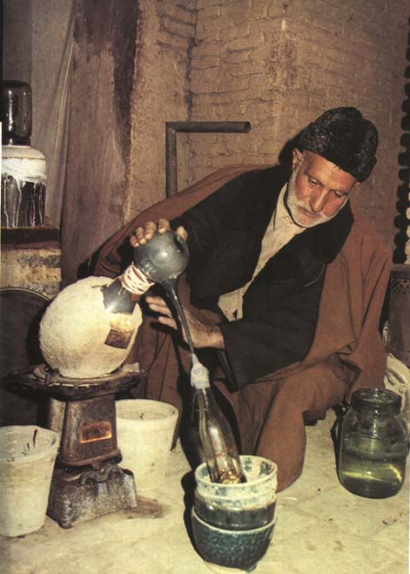








I. Principles of safety work at chemical laboratory
1. Laboratory works can be carry out only in the laboratories equipped according to the character of work
2. Laboratories must be equipped with:
- personal protective equipment
- fire means
- means for providing first aid,
- water supply
- asanation and neutralizing agent according to the nature of work.
3. Entry to the laboratory must be labelled according to the nature of work notice board, for example ban with open fire, an indication of industrial gases.
4. Plant, equipment and utensils must be maintained in operable and safe condition. Escape routes and handling facilities, closures of water, gas and electricity must be permanently marked and free, respectively accessible.

Slide 56
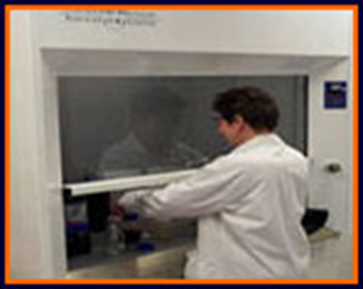
I. Principles of safety work at chemical laboratory
5. Laboratory vessels must not be used when eating, drinking, storing food. Food or drink intended for human consumption must not be stored in refrigerators and freezers for chemical and biological material.
6. In the laboratory it is forbidden to eat, drink and smoke. For this purpose special places must be set aside.
7. For works, which may lead to leakage of harmful chemicals into the air, it must be ensured ventilation (work in the hood!).
8. Use of unsuitable or damaged equipment, tools and laboratory containers is prohibited.

Slide 57
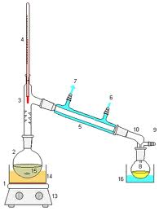
I. Principles of safety work at chemical laboratory
9. When working with pressure or vacuum in a glass apparatus, suitable containers must be used. Glass apparatus must be placed in a closed hood or protected by cover (shield of organic glass or metal mesh). Shield or goggles can be used only in exceptional cases technically justified.

Slide 58

I. Principles of safety work at chemical laboratory
10. Oil baths can be heated only by a flash point of oil. In a possible intrusion of water into the heated bath, heating must be stopped and the oil changed.
11. When working in a laboratory, used apparatus should be carefully assembled. Glass apparatus, particularly apparatus for vacuum distillation, must be properly checked before use (cracks, scratches). Damaged glass must not be used.
12. Sealed glass tubes n which chemical reactions take place, it is necessary to protect with metal housing. When handling them, especially when opened, the workers must protect themselves with shield and with protective gloves.
13. All work with hazardous substances must be technically secured so as not to exceed the maximum permissible exposure of employees to chemical agents.

Slide 59
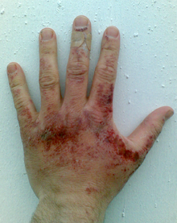

I. Principles of safety work at chemical laboratory
14. When working with hazardous substances, direct contact of workers with these substances must be excluded by technical measures. Personal protective equipment must be used according to the nature of work. When working with substances which irritate and burn the skin, for example caustics, or it degreases (organic solvents) employees must be equipped with protective ointments according to the nature of work.
Alcali burns
(by sodium hydroxide)

Slide 60
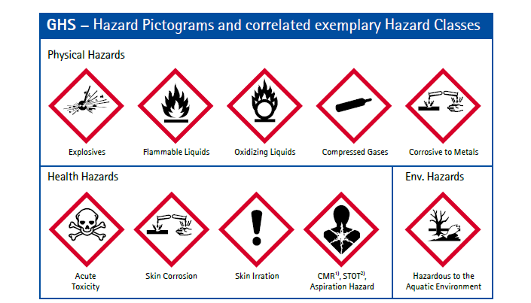
I. Principles of safety work at chemical laboratory
15. Each substance in the laboratory must be labelled. Substances that are poisonous, corrosive, flammable liquid, chemical carcinogens under the relevant legislation, must be labelled according abovementioned rules and handled them under these rules.
Labelling of hazardous substances according to the CLP / GHS

Slide 61
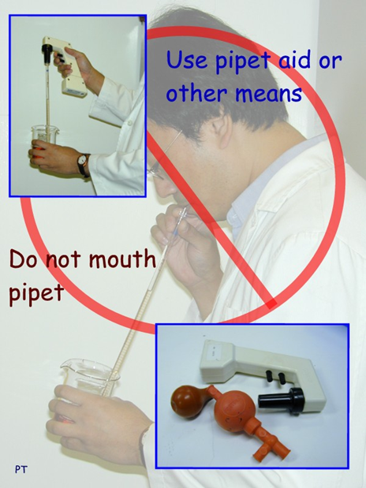
I. Principles of safety work at chemical laboratory
16. It is forbidden to suck solutions of hazardous substances to the pipettes by mouth. Safety pipettes must be used or must be sucked using vacuum.
17. Spilled acid should be immediately flushed off with water, or neutralize with sodium carbonate (soda powder) and then again flushed off with water.
18. To remove spilled nitric acid and other strong oxidizing compounds (chromo-sulfuric acid) may not to be used sawdust, textiles or other organic substances.
19. When working with non-polar solvents is necessary to exclude the formation of static electricity.
20. In the separation works, while working with flammable liquids, is necessary to prevent the formation of explosive mixtures in the laboratory and eliminate sources of ignition and fire.
21. When spilling the flammable liquids must immediately turn off gas appliances in the room, turn off the electric current from outside the room, declared the prohibition of entry by unauthorized persons and ensure good ventilation (not to the hallway).

Slide 62

I. Principles of safety work at chemical laboratory
22. By prolonged contact with atmospheric oxygen some solvents, such as di-alkyl ethers, dioxane, furan, tetrahydrofuran, Cellosolve, glycol ethers, 2-propanol and unsaturated hydrocarbons form peroxides. Work with those solvents must be carried out in hood with lowered protective glass. Where it is not possible for operational reasons to work in a fume cupboard shield or goggles must be used at work.
23. Any manipulation with alkali metal hydrides, solutions of organometallic compounds and strong oxidizing agents should be carried out by wearing protective equipment for eye and face protection.
24. Containers of corrosive liquids shall be stored so that they are safely reachable for all laboratory workers, not higher than of the shoulders.

Slide 63
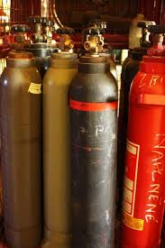
I. Principles of safety work at chemical laboratory
25. In the laboratory, the cylinders of technical gases, which are necessary for the operation may be only placed. Unnecessary or empty bottles should be removed. They must be secured in top half by chain or placed in fixed or mobile stands against the fall. Doors of rooms in which are cylinders of compressed gases must be labelled with the names of the corresponding gases.

Slide 64
I. Principles of safety work at chemical laboratory
Storage of hazardous substances
Hazardous substances may be stored only at places designated for this purpose, in the prescribed amounts and in appropriate safety containers. On the packaging their content and safety symbols must be stated .
During the decantation or pouring over of liquid chemicals the vessels must be arranged so that it does not come to their overturning or crashing. Liquids from larger vessels are decanted using tipping baskets or special pumps. Solid compounds must be laded using scoops, laboratory spoons or spatula which are from materials non reactive with given compounds.
Space for storing hazardous substances must be marked with safety symbols. Workplace must be supplied by sufficient amount of sanitation means. In case of spillage of substances, sanitation of contaminated areas should be carried out immediately.

Slide 65
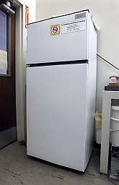

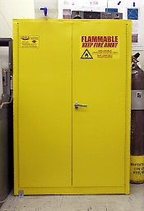
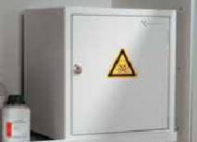
I. Principles of safety work at chemical laboratory
Storage of hazardous substances
Recomended storage methods for hazardous substances
Repository
for flammable liquids
Box for toxic
substances
Laboratory
refrigerator
Repository
for chemicals

Slide 66
I. Principles of safety work at chemical laboratory
Storage of hazardous substances
Incompatibilities by Hazard Class
 | Acids, inorganic | Acids, oxidizing | Acids, organic | Alkalis (bases) | Oxidizers | Poisons, inorganic | Poisons, organic | Water- reactives | Organic solvents
Acids, inorganic |  |  | X | X |  | X | X | X | X
Acids, oxidizing |  |  | X | X |  | X | X | X | X
Acids, organic | X | X |  | X | X | X | X | X
Alkalis (bases) | X | X | X |  |  |  | X | X | X
Oxidizers |  |  | X |  |  |  | X | X | X
Poisons, inorganic | X | X | X |  |  |  | X | X | X
Poisons, organic | X | X | X | X | X | X
Water- reactives | X | X | X | X | X | X
Organic solvents | X | X |  | X | X | X
http://www.lbl.gov/ehs/chsp/html/storage.shtml

Slide 67
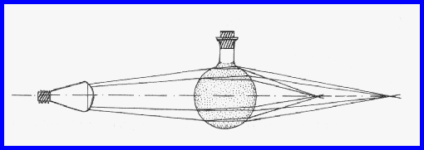
I. Principles of safety work at chemical laboratory
Storage of hazardous substances
Acids should be stored in cold rooms and must be protected from frost and direct sunlight. To the warehouse of acids any other items should not be placed. For emptying of large containers of acids and other caustic substances appropriate tipping devices must be used. If these substances are flammable liquids, the relevant provisions relating to the flammable liquids should be applied. They shall be placed so that at breaking the package, their content does not mix with other substances.
Light sensitive substances must be stored in dark glass containers or opaque material.
Containers with liquids, where rounded package acts as a convex lens, must be protected from sunlight.
Those substances that react dangerously with each other such as oxidizing agents and flammable substances shall be stored separately according to their chemical nature.
Attention should also be paid to waste disposal !!!

Slide 68

II. Rules of work with toxic substances
Work with toxic substances and other hazardous chemical agents shall be limited to the minimum extent possible. They may be used only where it is impossible to replace them with substances or work practices that are less dangerous. At work the personal protective equipment (PPE) is used to exclude the direct contact with these substances.
Containers with toxic substances or alkalis shall not be transferred open. They may be transferred only in protective packaging preventing breakage or spills (e.g., in plastic buckets).

Slide 69


II. Rules of work with toxic substances
Employees and other authorized persons (PhD students, persons on study stay), that manipulate with toxic substances and other hazardous chemical agents, must know:
the nature and effects of these substances in terms of health, their treatment, protective measures to be followed and the principles of first aid.
In dealing with hazardous substances each employee must proceed in order not to threaten the health and safety of humans, animals and the environment, to use them only to the extent strictly necessary and to prevent their misuse or theft.

Slide 70
II. Rules of work with toxic substances
II.1. Specific protective and preventive measures for the storage of toxic substances
In the organization toxic or very toxic substances and mixtures are stored in a central chemical storage. They are stored in a locked metal box, labelled „Toxic substances“. The storage is locked and secured against burglary.
Small amounts of toxic substances necessary for chemical analysis or synthesis are stored in the laboratories of organizational units in locked boxes secured against burglary and labelled „Toxic substances“ (referred to as „stores of organizational units“)
Group of toxic substances and mixtures and group of highly toxic substances and mixtures are stored separately.

Slide 71


II. Rules of work with toxic substances
II.1. Specific protective and preventive measures for the storage of toxic substances
In central chemical storage and stores of organizational units it is alloved to store also other nontoxic chemicals except for substances as are:
human medicines, veterinary medicines and pharmaceuticals,
narcotics, psychotropic substances and preparations,
c) foods,
d) feed,
e) explosive substances and preparations,
f) flammable substances

Slide 72
II. Rules of work with toxic substances
II.1. Specific protective and preventive measures for the storage of toxic substances
Receiving, stocks and issuing is recorded in the „Book of very toxic substances“.
Book of very toxic substances
Substance name: ………………………………………………
Batch | Date | Doc. ⋕ | Receiving | Issuing | Stock | Receiver | Receivers signature | comment

Slide 73
II. Rules of work with toxic substances
II.1. Specific protective and preventive measures for the storage of toxic substances
For receiving to the store, recording, storage and issuing of toxic substances and other hazardous chemical agents from the central chemical storage an authorized employee from economic section is responsible. Takeover of toxic substances and products directly from suppliers without an agreement of authorized employee and the proper records is prohibited for workers of the organization.
Issuing of very toxic substances and mixtures from the central store is subject to the written approval of the management staff noted in the Book of Very toxic substances.
In the event that the toxic substances and other hazardous chemical agents are not used during the workday, employees who adopt them are required to deliver them to stores of organizational units, or secure them in other reliable manner.

Slide 74
II. Rules of work with toxic substances
II.1. Specific protective and preventive measures for the storage of toxic substances
The pertinent laboratory personnel is responsible for possible misuse or theft of quantities respectively packages of taken over very toxic substances and mixtures. Specific consumption of those substances in the experiments is recorded in their personnel working protocols.
Within the organizational unit authorized staff is responsible for the store receiving, recording, storage and issuing of toxic substances and other specified hazardous chemical agents. Unauthorized persons must not have access to the store of toxic substances. The heads of the organizational units immediately notify the loss or theft of toxic substance to managing staff.

Slide 75
Measures in case of accidental emergencies and accidents
Organizational and technical measures to eliminate hazardous chemical agents
The first immediate measures to mitigate the consequences of an accident are carried out by the employees themselves or managed by the executives until the arrival of the intervention manager.
The employees notify fire of chemical substances to the senior employee managing work with hazardous chemical substances, fire engineer and fire patrol and try to extinguish the fire with available means (powder or snow fire extinguishers). The occurrence of a larger-scale fire is notified also to the head of the Technical Department, and call the Fire and Rescue Corps.
The intervention in the case of major accident is managed by safety engineer and in his / her absence by further authorized employees (refered as intervention manager).

Slide 76
Measures in case of accidental emergencies and accidents
Organizational and technical measures to eliminate hazardous chemical agents
Only the authorized employees who have been approved to carry out decontamination, repairs and other necessary work temporarily work in the affected area. Against harmful effects of released hazardous chemical agents they protect themselves by personal protective equipment (protective clothing, suitable protective footwear, gloves, face shield, respiratory protection).
First aid staff or a safety engineer provide first aid to persons injured or affected by dangerous chemical agents, transporting them to a safe place, calling emergency services or transporting to hospital.
Other employees who do not participate in the accident removal, interrupt or stop their work, leave the workplace and go to a safe place.

Slide 77
Measures in case of accidental emergencies and accidents
Organizational and technical measures to eliminate hazardous chemical agents
Procedure for disposing and removing hazardous chemical substances
Spills of flammable liquids:
- Switch off the burning gas appliances immediately in the room
- From the outside, turn off the power
- Declare no access to unauthorized persons
- Prepare fire extinguishers for possible use
- Ensure effective ventilation, but not into inside the building
Spilled flammable liquid is allowed to soak into a suitable sorbent. Sawdust or fabric can be used. From commercial sorbents Spilkleen or Vapex.
Spilled non-polar solvents must not be spread on the floor or on a plastic backing (risk of static discharge).
To remove the spilled liquids only those sorbents can be used, which do not ignite even after they have been soaked with flammable liquids.

Slide 78
Measures in case of accidental emergencies and accidents
Organizational and technical measures to eliminate hazardous chemical agents
Procedure for disposing and removing hazardous chemical substances
Spills of flammable liquids:
Spilled acids are partially diluted with water and neutralized with available carbonate, e.g. calcium or sodium. If carbonates are not available, use hydroxides. The liquid waste is pumped or trapped under suitable conditions (see above). In small amounts, the spilled acid, after dilution and neutralization, can be entrapped in the fabric, e.g. into a rag, and rinse in water.

Slide 79
Measures in case of accidental emergencies and accidents
Organizational and technical measures to eliminate hazardous chemical agents
Procedure for disposing and removing hazardous chemical substances
When solid chemicals are spilled, they are carefully collected and sweeped so that dust particles do not disperse into the surrounding space. Instead of sweeping, the spilled material can be collected using a squeegee (blade edge, straight piece of cardboard). The remainder of chemical is collected on a moistened cotton wool, fabric or other sorbent.
The sorbent with entrapped chemical is placed in a suitable plastic or metal container. The used sorbent is treated as hazardous waste (depending on the nature of the chemical). It is temporarily placed in a hazardous waste storage and then handed over to an authorized company for disposal.

Slide 80
Measures in case of accidental emergencies and accidents
B. Reporting of hazardous chemical agents leakage
B.1. Reporting within the organization
An employee who finds out or suspects an accident shall notify this fact personally or by telephone to his head or his deputy and, subsequently, and then, according to the severity, to other managers. Appointed persons come to the accident site quickly.
B.2. Reporting outside the organization
A senior employee managing work with hazardous chemical agents and a executive employee for the relevant workplace report the severity of the accident to emergency services, environmental authorities and civil protection.

Slide 81
Measures in case of accidental emergencies and accidents
Emergency services, regional public health authorities | Phone | Comment
Rescue service | 155, 16 155, 112
D. Gajdošová, M.D., general practitioner in area of SAS, Dúbr. cesta 9, BA | 02 / 5477 2559
NATIONAL TOXICOLOGICAL INFORMATION CENTRE FNsP, Limbová 5, 833 05 BA, www.ntic.sk, tic@healthnet.sk | 02/5477 4166 02/54652307
Fire fighting service | 150, 112
District authority Bratislava, Environmental Care Department, Tomášikova 46, 832 05 Bratislava 3 - sekretary | 09610/46 602
Regional Public Health Authority, www.szuba.sk | 917 426 111 02/4333 8286
Main gate-house of area of SAS in „Patrónka“, Dúbravská cesta 9, Bratislava | 02/ 5477 5722, 0903 764 978
Civil Protection and Crisis Management Department of the District authority of BA | 09610/46 324
Police | 158, 112

Slide 82
Measures in case of accidental emergencies and accidents
Protective and preventive measures
Workplaces where hazardous chemical factors are stored are labeled with safety labels and provided with sufficient amount of decontamination and neutralizing agents and, depending on the nature, with fire extinguishers.
Escape routes and handling spaces, water, gas, and electric current closures are marked in accordance with a special regulation (Regulation of the Government of the Slovak Republic No. 387/2006 Coll.) and are kept permanently free, respectively accessible.

Slide 83
Measures in case of accidental emergencies and accidents
Protective and preventive measures
Training and informing employees of the hazards arising from the nature of the operation, the precautionary and preventive measures to prevent exposure and the procedure in the event of an accident related to the use of a hazardous chemical substances, are performed by:
within the entire organization, senior employee resposible for the safety work with hazardous chemical substances together with the safety engineer and the civil protection officer,
at a particular workplace, a head of organisation units or laboratories instructed by senior employee resposible for the safety work with hazardous chemical substances.

Slide 84
Measures in case of accidental emergencies and accidents
Protective and preventive measures
Employee Training in First Aid Assistance is organized by a safety engineer and provided by healthcare professionals.
The first aid kits is provided by the Economic Department of the organization.
Fire safety training is carried out by the fire engineer. Intervention training is carried out by the safety engineer.

Slide 85
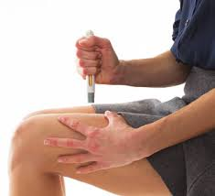
Pre-medical first aid and general principles of poisoning treatment
The first aid as well as other treatments are governed by the following principles:
interrupt the action of the toxic substance and prevent its further absorption,
eliminate the toxic substance from the body,
neutralize the toxic substance by submission antidotes,
maintain vital functions (breathing, blood circulation),
provide medical assistance and transport to the hospital.
For more information concerning giving first aid on National Health Service (NHS, UK): https://www.nhs.uk/conditions/first-aid/

Slide 86
Pre-medical first aid and general principles of poisoning treatment
Prevent further absorption of toxic substance
The further absorption of the toxic substance is prevented according to the mechanism of its effect and the portal of entry into the organism.
Inhalation poisoning
In case of poisoning with gases and vapors, the victim should be removed from the contaminated environment as soon as possible and his clothes loosened. Most inhaled gases and vapors are removed from the body by exhalation. Therefore, it is important to keep a good breathing function.
Intoxication by absorption through the skin
The most important action is to remove clothing contaminated with toxic or caustic substance, thoroughly washing the affected body portion with a flow of water, at affecting with benzene or phenols, washing with soap and then with water. We do not use soap when there are more advanced pathological changes on the skin. In these cases we proceed like at burns and particularly we try prevent shock.

Slide 87
Pre-medical first aid and general principles of poisoning treatment
Oral poisoning
By oral poisoning, remnants of unabsorbed toxic substance should be removed from the gastrointestinal tract as soon as possible by inducing vomiting, gastric lavage and laxatives. If the person is spontaneously vomiting and has diarrhea, we do not try to diminish them, but if the person's health permits, we support them.
Vomiting. We induce it, eventually support it by drinking warm salt water prepared by dissolving the teaspoon of table salt in a liter of water. Vomiting is not induced if the person is unconscious, in convulsions and after ingestion of caustic to avoid erosion of the burned esophagus.
Gastric lavage. The stomach is pumped with lukewarm water or salt water, prepared by dissolving the teaspoon of salt in a liter of water.

Slide 88
Pre-medical first aid and general principles of poisoning treatment
Neutralization of toxic substance by administration of antidotes
If the absorption of the toxic substance into the organism is not prevented, we try to neutralize the toxic substance by administering antidotes. The universal antidote under normal laboratory conditions is active charcoal.
Maintain vital functions
By severe poisoning, when unconsciousness and respiratory or blood circulation arrest may occur, it is essential to start the resuscitation immediately following the procedure:
a/ clean the oral cavity,
b/ put the affected person on the hard and flat surface,
c/ tilt the head,
d/ make 30 chest compressions by about 5 cm,
e/ clog the nose
f/ perform 2 artificial breaths from mouth-to-mouth,
g/ continue in resuscitation in 2 breaths: 30 chest compressions; chest compressed at a rate of at least 100 per minute, until spontaneous cardiac and respiratory activity is restored or rescue service arrives.

Slide 89
Pre-medical first aid and general principles of poisoning treatment
Shock measures
Signs of shock can include weak, rapid pulse, pale, cold, clammy skin, faintness and nausea. The affected person is restless, confused and disorientated, has rapid and shallow breathing.
Proceed as follows:
a/ place the affected person comfortably and actively calm him down,
b/ maintain his body warmth with a blanket or a cloak, to prevent hypothermia,
c/ raise his legs (unless they have fractures) by about 30 cm (autotransfusion, anti-shock position),
d/ call for medical help, dial 112 or 155
e/ monitor consciousness, breathing, pulse and skin colour at regular intervals
https://healthywa.wa.gov.au/Articles/F_I/First-aid-for-shock
https://en.wikibooks.org/wiki/First_Aid/Shock
.

Slide 90
T E S T
Please open the test by copying the link below
into your web browser
and logging in to your account
... @ bmc.onmicrosoft.com
https://forms.office.com/Pages/ResponsePage.aspx?id=H7kRTHPTG0KJ4A5wpQVmolM3IcL8lMhNj4FCUxNOayZUOVlEVUkxVU43TFBUTzlEWFNWMUNOS1owUy4u

Slide 91

Thank You
For more information:
Csaba Kósa, PhD.,
Slovak Academy of Sciences
Csaba.Kosa@savba.sk

